Slide 1
East versus west: A Global Divide and a Cold War

Slide 2
A Global Divide
Cold War = 1946-1991
2 global superpowers → United States versus the Soviet Union
2 global military alliances → NATO versus the Warsaw Pact
The Iron Curtain = the Soviet-created, heavily fortified border splitting non-Communist Western Europe and Communist Eastern Europe

Slide 3
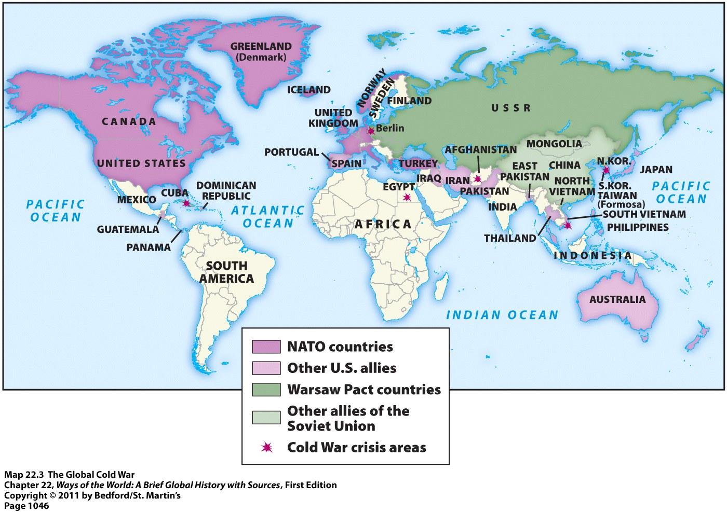
A Global Divide

Slide 4
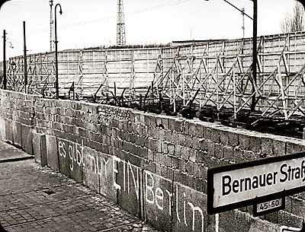
The Berlin Wall
Became a universal symbol of the Cold War
Built by East Germany (with Soviet backing) in 1961 to stop East Germans from fleeing to West Berlin

Slide 5
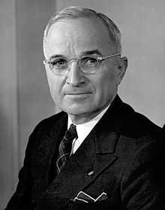
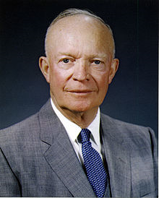
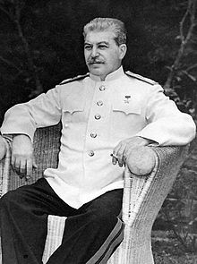
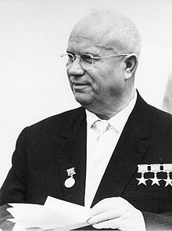
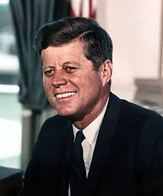
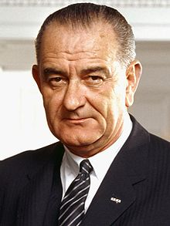
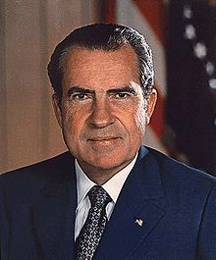
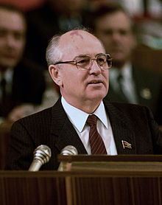
Leaders During the Cold War
United States
Soviet Union

Slide 6
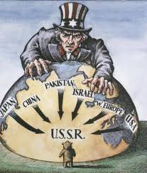
Policy of Containment
The United States developed a new foreign policy = containment
Designed to stop the spread of communism
This policy led the U.S. to get involved in several Cold War conflicts:
Korean War
Vietnam War
Conflict in Afghanistan
Cuban Missile Crisis

Slide 7
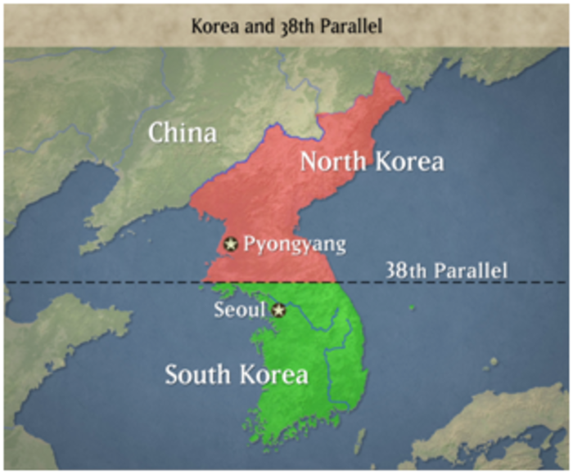
Korean War (1950-1953)
After WWII, Korea was divided at the 38th parallel
Northern half = to be temporarily occupied by the Soviet Union
Southern half = to be temporarily occupied by the U.S.
By 1948 = 2 separate governments had emerged
North Korea = Communist
South Korea = Democratic
By mid-1949 = both the United States and the Soviet Union had withdrawn all of their troops from North and South Korea

Slide 8
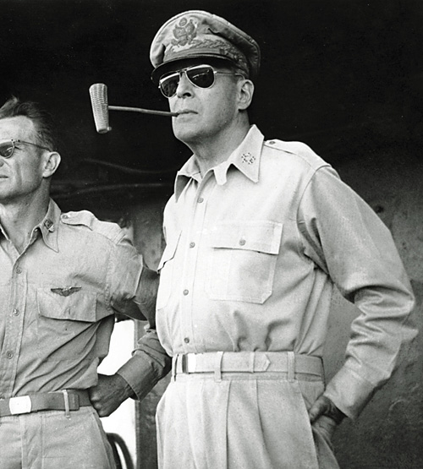
Korean War (1950-1953)
June 1950 = North Korea invaded South Korea → wanted to unify the country under a communist government
United Nations meets in response
Voted to condemn the invasion
Agreed to organize an army to oppose it
16 countries contributed troops to UN army → but 90% of those troops came from the U.S.
Leader of the UN army = Douglas MacArthur

Slide 9
Korean War (1950-1953)
Brief game of back-and-forth followed by a long stalemate
First few months of war = North Koreans swept southward and conquered almost all of South Korea
September 1950 = UN forces launched a counterattack, pushed the North Koreans out of South Korea, and advanced until they had conquered almost all of North Korea
Communist China came to the aid of North Korea → Chinese forces and North Koreans able to push UN forces back to a line near the 38th parallel

Slide 10
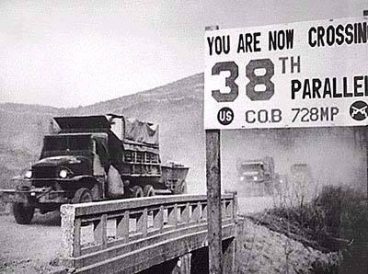
Korean War (1950-1953)
July 1951 – July 1953 = stalemate along this line near the 38th parallel
July 1953 = truce was signed → both sides agreed to divide Korea (once again) along the 38th parallel
5 million deaths and mass devastation of much of Korea → for what?

Slide 11
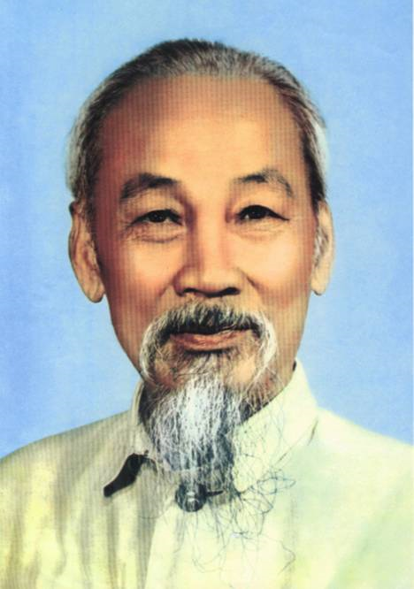
The Vietnam War (1955-1975): First Indochina War
Before WWII = France controlled Indochina (including Vietnam)
After the Japanese left Indochina following WWII = France wanted to regain control of Vietnam
A Vietnamese nationalist group had developed, however, that wanted an independent Vietnam = called the Vietminh
Leader = Ho Chi Minh
This group = communist
Supported by the Soviet Union and China

Slide 12
First Indochina War
Vietminh and France could not agree on how to share power in Vietnam
1946 = two sides went to war
U.S. sent military and financial aid to help France
French still couldn’t pull out a victory
May 1954 = French forces defeated by the Vietminh in the decisive battle at Dien Bien Phu

Slide 13
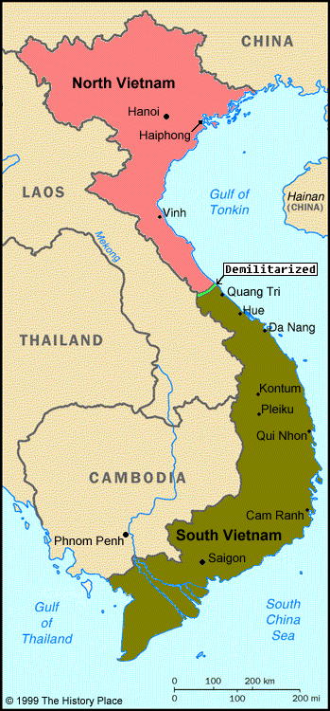
First Indochina War
One month before this battle = the Vietminh, France, and U.S. met to negotiate a settlement to the Vietnam conflict
They agreed to divide Vietnam along the 17th parallel
Created a communist North Vietnam and a democratic South Vietnam
Division supposed to last until 1956 = when elections were to be held
Ngo Dinh Diem (leader of South Vietnam) rejected the proposed elections
Diem = weak and unpopular
Ho Chi Minh = VERY popular

Slide 14
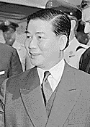
First Indochina War
Viet Cong = communist guerrillas in South Vietnam → fought Diem in hopes of uniting Vietnam under Ho Chi Minh
Diem = weak and unpopular leader, even with his OWN people
1963 = South Vietnamese military staged a coup in which Diem was killed
Thought that if he continued to be in power, the south would fall to the Communists
U.S. quietly approved of this coup

Slide 15
The Vietnam War
By late 1963 = 16,000 American advisors were in Vietnam
1964 = U.S. approved of secret South Vietnamese naval raids against North Vietnam
August 2, 1964 = U.S. President Lyndon Johnson announced that North Vietnam had fired on 2 U.S. ships off the coast of Vietnam
Incident never confirmed
President Johnson used it to increase American involvement in the war
U.S. Advisors in Vietnam

Slide 16
The Vietnam War
Congress passed the Gulf of Tonkin Resolution = gave the President broad war powers
March 1965 = Johnson sent first ground troops to Vietnam
By 1968 = more than 500,000 American troops were in Vietnam
South Vietnamese army = numbered 800,000
North Vietnamese army and the Viet Cong = numbered 300,000
China and Soviet Union sent aid, but no troops, to help North Vietnam

Slide 17
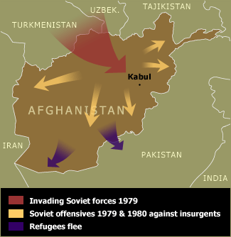
Conflict in Afghanistan
1978 = a Marxist party had taken over power in Afghanistan
Marxist leaders took steps to:
Implement radical land reforms
Liberate women
Problem = this upset conservative Muslims within the country and led to a large opposition movement
Soviet Union = intervened with its military
Afraid that this new communist regime in Afghanistan would be overthrown and replaced by Islamic radicals
Got caught up in a war they could not win → lasted from 1978 until 1989
Soviet Soldiers in Kabul, Afghanistan

Slide 18
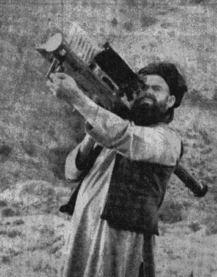
Conflict in Afghanistan
U.S. = sent aid to the Afghan guerrillas to help them oust Soviet forces and end the communist regime in Afghanistan
“Operation Cyclone” = code name for the CIA program to arm, train, and finance the Afghan insurgents during their war against the Soviets
Soviet forces finally withdrew in 1989
Afghan communist regime soon collapsed
Afghan insurgent using a U.S. “stinger” missile

Slide 19
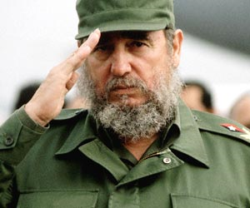
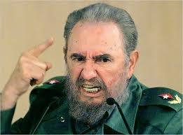
The Cuban Missile Crisis
1959 = Fidel Castro came to power in Cuba
Revolutionary nationalist
Liked Marxist ideas → led him to establish a communist regime in Cuba in 1960
Soviet Union = pumped! → 1st time a country had set up a communist government without the Red Army
Nationalized American assets in Cuba = brought them under ownership of the Cuban government
Provoked a lot of U.S. hostility
U.S. stopped all aid to Cuba AND all imports of Cuban sugar

Slide 20
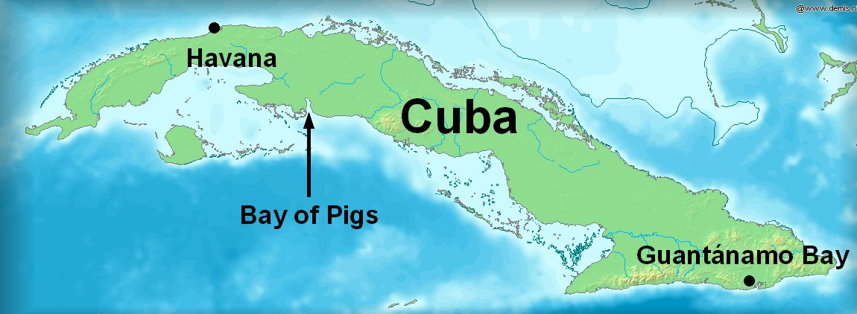
The Cuban Missile Crisis
April 1961 = Bay of Pigs Invasion
CIA funded, trained, armed, and transported 1300 Cuban exiles to invade Cuba
Landed at the Bay of Pigs
Goal = to overthrow Castro
Invasion = a disaster; President Kennedy was humiliated
Major Result = Castro asked the Soviet Union to provide him with weapons to protect Cuba against America

Slide 21
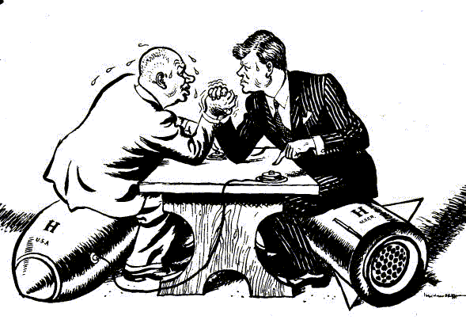
The Cuban Missile Crisis
Leader of the Soviet Union at this time = Nikita Khrushchev
Feared that American aggression against Cuba would lead to the loss of this new communist ally in the Caribbean
He secretly deployed nuclear-tipped Soviet missiles to Cuba → thought this would stop any further U.S. action against Castro
Soviet Union quickly and secretly built missile bases in Cuba

Slide 22
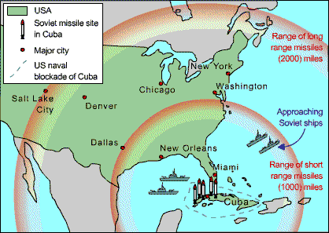
The Cuban Missile Crisis
October 1962 = missiles discovered by the U.S.
For 13 days = American forces blockaded Cuba and prepared for an invasion
Agreement struck between President Kennedy and Premier Khrushchev
Both knew nuclear war would be absolutely devastating
Soviet Union agreed to remove ALL missiles from Cuba
U.S. promised to not invade Cuba

