Slide 1
Chapter 3: Socialization, the Life Course, and Aging
Notes:
In the last class we talked about what culture is, and now it is important to learn how culture is carried on. That brings us to our topic of discussion for today: socialization.

Slide 2
What is socialization?
Socialization is a process of social interaction through which people acquire (1) personality and identity and (2) the way of life of their society.
Through socialization, we internalize the culture of our society.
The result of successful socialization is that the world becomes so comprehensible that we can take it for granted.
Notes:
Though culture is something that we, as a society, create, once it is “out there,” it acts back upon us. That is to say that culture becomes a social force that has powerful consequences on us. Perhaps the first place in our lives where culture shows its influence is in the process of socialization.
Human infants, for example, are born not having any idea how to behave in social situations. They eat, sleep, relieve themselves, and cry; by and large, all the rest must be taught, and that happens in the process of socialization. Biology has to be manipulated by culture, so that these infants, as they get older, will understand their own culture so fully that it will feel natural. This happens through socialization.
It is, though, very important to recognize that socialization has two necessary parts: One is that we internalize culture, and the other is that we construct an identity. We’ll be going back and forth a bit between culture and identity (what you might be used to thinking of as personality), so just recall that both are crucial to the success of socialization.

Slide 3
Nature versus nurture
Socialization is a primary location for studying the significance of nature versus nurture in human behavior.
By looking at twin studies, feral children, isolated children, and institutionalized children, we can examine the effect of both nature and nurture on behavior.
A lack of language and interaction in childhood often leads to a life outside the mainstream of society.
3
Notes:
Before we move on to the process of internalizing culture and how that aids us in identifying construction, it’s worth mentioning that socialization is at the heart of the nature versus nurture debate. If our lives were utterly determined by our biology, by genetics, then socialization wouldn’t matter very much, if at all. But socialization does matter, and there are several ways we can consider this objectively as social scientists.
How do we measure the effects of socialization? Let me mention three possible ways:
Twin studies: where we examine the lives of twins who were raised separately—same (or very close) genes, different social environment
Feral/isolated children: where we examine the rare cases of children who were raised with no (or almost no) human contact
Institutionalized children: where we examine the lives of children who have had basic needs met, but little stimulation
What we learn from such studies—especially the latter two—is that when there is a lack of interaction with other people, normal behavior is nearly impossible. The social environment matters deeply for future functioning.

Slide 4
Socialization and social reproduction
Through socialization, the norms and values of society are carried on.
This process connects generations throughout their lives.
It is the process of sharing culture within family groups—primary socialization—that makes it feel inherited.
4
Notes:
As I’ve indicated, it is through the process of socialization—which I’ll discuss in more detail in just a moment—that the culture of a society is carried on. From one generation to the next, the norms, values, and behavioral expectations are taught and deviations are often punished or sanctioned. This process of teaching and learning is lifelong and is crucial to maintaining societal functions.
Another way of talking about this is to discuss social reproduction. Through socialization, society reproduces itself for better or worse. Values that we might consider negative, such as racial prejudices, are often taught to youngsters, intentionally or not. At the same time, it is through socialization that we learn the highest ideals of our society, all the way from the golden rule to good citizenship.
Again, when socialization is successful, it feels natural—which may feel, for some people, like it is inherited.

Slide 5
G.H. Mead and socialization
Mead understood socialization through the symbolic interactionist perspective.
He focused largely on primary socialization, that portion of the process that takes place with infants and young children.
Socialization occurs through children interacting with those around them and beginning to identify certain roles and behaviors as patterns.
5
Notes:
As I said earlier in the term, G.H. Mead was a symbolic interactionist. This means that he examined social life through the lens of interactions between people and the meanings that constitute and emerge from those interactions. He is perhaps best known for his work on socialization, wherein he studied the development of selfhood from its earliest stages.
In talking about the way that small children develop a sense of self, Mead examined what we call primary socialization. This is that part of socialization that takes place with very small children with their significant others, including parents, siblings, grandparents, and other important caregivers. During this stage, most of the learning takes place through observation and the imitation of behaviors.

Slide 6
G.H. Mead and socialization
Through this process, children develop a “me,” a social self (as opposed to an “I,” the unsocialized self).
Language is the primary vehicle for this learning.
Children first take on the roles and attitudes of their significant others first, and then those of the generalized other (which we may understand as culture).
6
Notes:
During primary socialization, children have two selves, the “I” and the “me.” The “I” is that part of the self that is spontaneous and unreflective. The “me” is the part of the self that is being shaped and molded by society; it is the social self, the part of the self that is observable. Let’s consider an example: A little boy falls while in a race with his buddies. The “I” is the part of the self that wants to cry from pain and embarrassment; the “me” is the part that tries not to cry because it is not socially okay for boys to cry and there are others watching. Our descriptions of people as individuals can really only come from the “me” since the “I” is not available for our perusal.
An important part of the process of interaction that leads to the development of the “me” is language. Without language, we would not be able to pass along the norms and institutions of our society without much more difficulty, if at all. It is language that serves as the medium by which distinctly human interaction is possible. As I’ve already said, children deprived of interaction, and therefore language, do not fit in well in our society.
So what actually happens in primary socialization? We’ll start with taking on the roles of the other. What happens is that, over time, infants learn that certain kinds of conduct are appropriate with certain kinds of people: gender roles, family roles, and so on. For children it is largely through play and games that they learn to actually act out these parts. What are examples of some kinds of play where children are learning roles? House, dress-up, cops and robbers . . .
At the same time they begin to recognize roles, children also start taking on the attitudes of the other. That is, they begin to associate certain meanings with those roles and behaviors. Prior to having the ability to talk, infants learn to understand the meaning of gestures, expressions, tone of voice (regardless of the actual words), and so on.
The next thing that happens is generalizing the other. Here, the child learns to relate to, not just significant others, but also other people.
At this stage, the child begins to understand that attitudes and roles pertain, not only to specific people, but also to broader roles and attitudes (for example, children think that all women of some general age are “moms”). Roles and attitudes have gone from the particular to the universal. Now there are generalized norms and meanings.
It is at this stage that we appropriate society: the “generalized other” is culture, it is society. The outside world becomes our world and is embedded deeply in our consciousness.

Slide 7
Jean Piaget: Stages of cognitive development
Sensorimeter (birth–2 years): exploring the environment
Preoperational (2–7 years): egocentric
Concrete operational (7–11 years): basic abstraction
Formal operational (11–15 years): further abstraction and hypothetical reasoning
7
Notes:
Another important perspective on socialization is Jean Piaget’s work on stages of cognitive development. What interested him was the development of the way children make sense of the world around them, and he described four general stages:
First there is the sensorimeter stage, where the infant begins differentiating herself from her environment. Over the course of the first two years of life, she will begin to distinguish between self and other, via sensory exploration: touching, tasting, watching, and so on.
Second is the preoperational stage. Here children gain mastery of language and thereby the ability to interact with others. This stage is often referred to as egocentric because during this period a child only sees the world from his own perspective; there is, as of yet, no development of empathy.
The third stage is the concrete operational stage, and here a child develops the beginnings of abstract thought and the ability to deal with more complex problems. The child is now less egocentric.
Finally, according to Piaget, comes the formal operational stage, which he claimed some people never achieve. By adolescence, most people will have gained the ability to deal with more complicated levels of abstraction and to identify multiple explanations for problem solving. A certain amount of formal education is very important in mastering the skills of this stage of development.

Slide 8
Agents of socialization
These are the most significant groups and institutions within which socialization occurs:
Family
Schools
Peer groups
Workplace
Mass media
8
Notes:
Agents of socialization are, as the slide suggests, the groups and institutions that have the greatest influence on us in terms of socialization. During primary socialization, the family is far and away the most important agent of socialization. After that, schools, peer groups, and mass media begin to compete for influence, which explains the great deal of energy and concern parents place on these institutions. Schools, for example, teach us, not only formal educational lessons, but also rules of behavior in group settings, norms for relationships with authority figures, and even how to view ourselves vis-à-vis the way our teachers treat us.
As adults, our workplaces are often sites for what we call secondary socialization, a process during which we are socialized into some new role. Other arenas for secondary socialization include the military, college, prison, and other social settings in which we immerse ourselves.

Slide 9
Social roles
Roles are fixed patterns of conduct.
The concept of fixed roles allows us to speak in broad terms about certain figures: for example, mother, teacher, doctor.
In reality, roles are not fixed, but rather are continually constructed by individuals with agency. Our socialization into roles is ongoing.
9
Notes:
Much of what we learn during socialization is what constitutes particular social roles. For example, children typically learn very quickly what (in their home) is a mommy-role and what is a daddy-role. So what are roles? Roles are patterns of conduct that we usually think about as fixed. In reality they shift but, of course, as small children we don’t know that.
Through our experiences with our families, schools, peers, and the media, we learn the basic contours of many roles, including parents, siblings, teachers, troublemakers, and many more. It’s important to recognize, however, that though the behaviors attached to these roles feel natural, that is simply the result of having been successfully socialized into a particular culture that supports them.

Slide 10
Socialization and identity
Socialization involves, not only the internalization of culture, but also the construction of self.
Each person has a social identity (objective identity) and a self identity (subjective identity). In fact, we typically have multiple social identities.
Sources of social identity include gender, race, nationality, and sexual orientation.
10
Notes:
We’ve been talking a lot about how we learn the norms of our society via socialization, but there is also another critical piece to consider: Socialization is also the process by which we construct our identities. Through socialization, we gain both a social identity and a self identity. Our social identity is what we can call an objective identity, as it is largely determined by external relationships, while our self identity is a subjective identity, meaning it is how we see ourselves. Our social identities are determined by many things, including gender, race, religion, job, marital status, and other social categories that others observe us in.

Slide 11
Socialization and identity
All people have multiple social identities, in large part because we all must interpret how different people view us (Cooley, “the looking-glass self”).
Our self identity is the one that we take on as being “true” or “real”; it is how we see ourselves.
Interaction between society and the individual shapes the self identity.
11
Notes:
All of us actually have many social identities. I am, for example, teacher, parent, child, sibling, employee, and many more. These are all objective identities, as they are the ways that other people know me, and my role varies with each one. We also all have a self-identity, which is essentially some combination of parts of these that we understand as our “true” self; it’s us “keeping it real.”
From a psychological perspective, we might think of something like personality, but sociologically it is important to think of this self-understanding as a kind of identity that is socially constructed. Usually we think of personality as something innate, even something we are born with, but identity is something we have to achieve, and is also something that can change. Identity is, in fact, a social process, not a static thing.

Slide 12
Traditional versus modern identities
The way identity is constructed has changed over time for at least four reasons:
Identity is no longer as deeply rooted in family.
There is a much higher degree of geographic mobility.
Religion is now more flexible, more changeable.
The social world determines less of who we are.
Self-identity counts for more today than in earlier periods.
12
Notes:
One interesting way of thinking about the construction of identity is the way in which this process has changed over time. It used to be that if you were born into a poor family, you would be poor. In fact, you would almost certainly “be” whatever it was your same-sex parent was. It also used to be that people didn’t move much, that religion was central to who they were, and that their community played a significant role in the construction of their identity. In essence, your social identity was your identity. In fact, the idea of having a unique sense of self is a modern idea.
Today, the construction of identity deals with a new situation where
family is no longer destiny (not that it’s not important, but there is much more social mobility today than in earlier time periods),
people move around a great deal,
religion is no longer a lifelong commitment nor determinant of self,
and because of all these changes, social identity is much more fluid and we have a much stronger sense of self identity. In fact, perhaps it is because of all of this change that our desire for self identity is nearly limitless (consider the therapeutic nature of our society for evidence of this).
As your textbook points out, today we have “unprecedented opportunities to create our own identities” (p. 77), and that is very much a function of the changes that have taken place in modern societies.

Slide 13
Gender socialization
Gender socialization refers to the process of learning “appropriate” gendered behavior through agents of socialization.
Though gender roles have changed, they remain prevalent and powerful.
Studies show that even parents who do not believe they are socializing their children according to gender in fact are doing so.
Notes:
Now that we’ve talked a great deal about socialization in general, let’s think for a few minutes about a particular type of socialization that happens the world over: gender socialization. In every society there are different social expectations for men and women, and we learn about these from the earliest days of our lives. Boys and girls are made aware in a multitude of ways what norms and behaviors are expected of them, and in many—if not all—societies, they are sanctioned if they deviate too strongly from these.
Though a great deal has changed in terms of gender roles here in the United States, which we’ll come back to later in the term, gender socialization remains a very powerful institution. We teach boys to be active and independent and girls to be docile and nurturing, even when we don’t realize we’re doing it. As your textbook points out, research has shown that if the same baby is dressed as a boy, adults treat that child one way, and if dressed as a girl, adults treat the child quite differently.

Slide 14
Gender socialization
This process has been found to begin before birth.
Parental presence and behavior play a role in gender socialization.
Toys, television, movies, and even books also contribute to differential role construction.
Cross-culturally, it is okay for girls to choose boy toys, but not vice versa.
Notes:
What is even more surprising is that this process begins before babies are even born. Now that most women find out the sex of their future babies about halfway through their pregnancies, research has shown that people treat the mothers-to-be of boys differently than those of girls. After birth, gifts and cards to the family continue to bear out gendered stereotypes, and at this point the process of gender socialization is well underway.
From the child’s perspective, the roles that parents take—who changes diapers, who cooks dinner, and so on—is all internalized in the process of primary socialization. The toys and books that parents bring home tend to reinforce cultural narratives that favor boys, as do television programs and movies aimed at small children. Again, strength and activity are “boy” traits, while passivity and beauty are “girl” traits. Even children’s clothing reinforces these ideas as small girls are put in dresses and tight-fitting clothes that inhibit movement, while boys are more frequently dressed in play clothes.
A final way of bringing home the point here is that in nearly all societies, while it is okay for girls to choose boy-typed toys and activities, it is not okay for boys to choose girl-typed things. The message is clear.

Slide 15
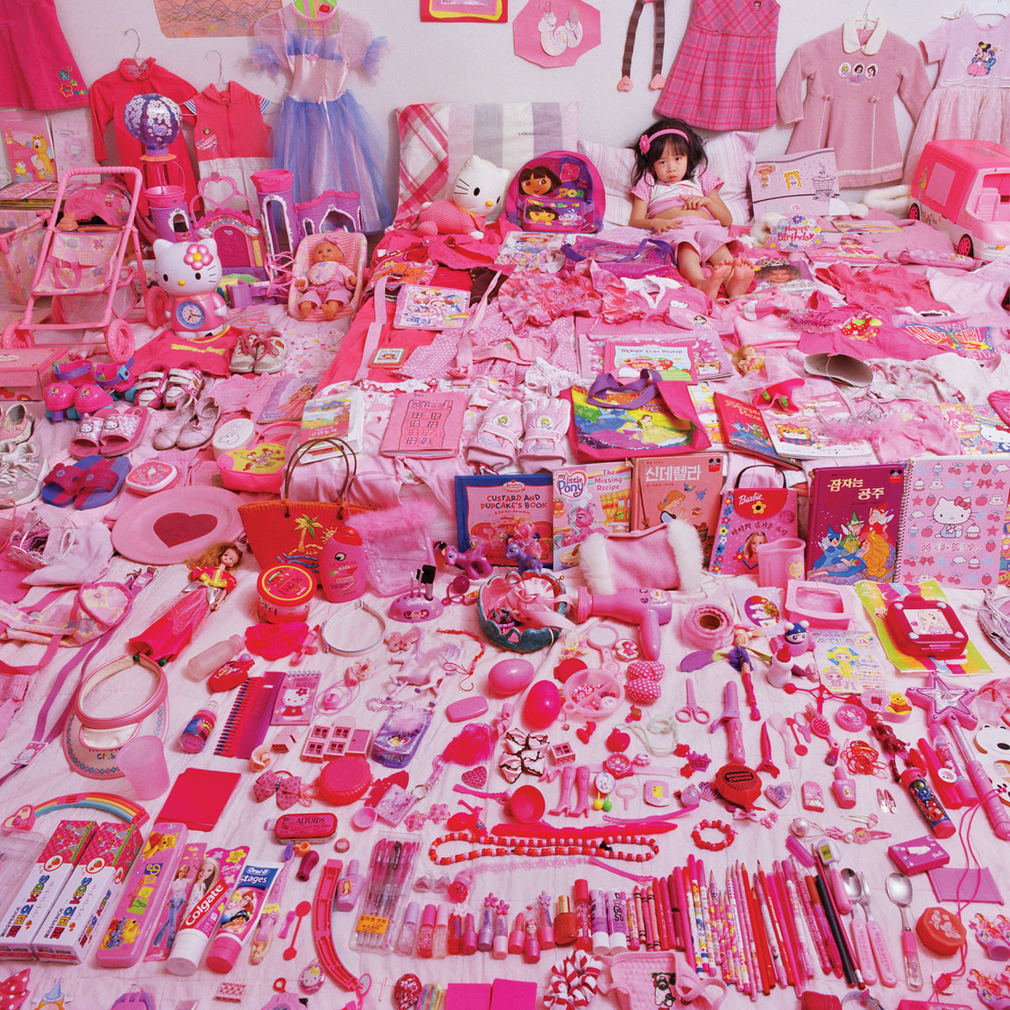
In her “Pink & Blue” project, photographer JeongMee
Yoon records girls’ obsession with the color pink.
Essentials Of Sociology, 3rd Edition
Copyright © 2011 W.W. Norton & Company

Slide 16
Stages of the life course
Human life is not only a biological process, but also a social one. Social scientists that are interested in how being human changes over time look at five stages:
Childhood
Teenager
Young adulthood
Midlife/middle age
Later life/old age
Notes:
One way of broadening the scope of our conversation about socialization is to consider the stages of the life course, an important subfield in sociology. Social research that takes this approach begins with the premise that human life is more than a biological process, and that there are in fact distinguishable social stages to the human life: childhood, teenager, young adulthood, midlife, and later life.
Social scientists that look at the life course examine variation between stages, as well as variation in the same stage in different societies or subgroups. They might also examine the way the life course has changed over time. For example, your textbook points out that childhood and teenager status are actually relatively new. One of the things we can learn from studying the life course, then, is how and why the structure of societies have changed to incorporate these new phases. Additionally, we are reminded of the dynamic nature of society and human social life.

Slide 17
Aging
Social gerontology is the sociological study of aging and the elderly.
This topic has grown in importance as the elderly have become the fastest growing segment of the population.
As life course approaches suggest, aging is not simply a biological process, but one that is affected by social structures and individual agency.
Notes:
In the United States today, the elderly (those aged 65 and older) are the fastest growing segment of the population. As medical care, quality nutrition, and changes in lifestyle have extended the lifespan, we now live in a society where quite significant portions of the population fall into this category. Not surprisingly, gerontological medicine and what we call social gerontology have grown as areas of specialization.
There have been several incarnations of theorizing about aging, beginning with functionalist perspectives that emphasized the adaptation to changing social roles that the elderly must go through, and what responses to those changes are good—functional—for society. Following that, theorists have taken on conflict explanations, and today, typically adopt more flexible, complex approaches that incorporate more agency on behalf of the elderly themselves.

Slide 18
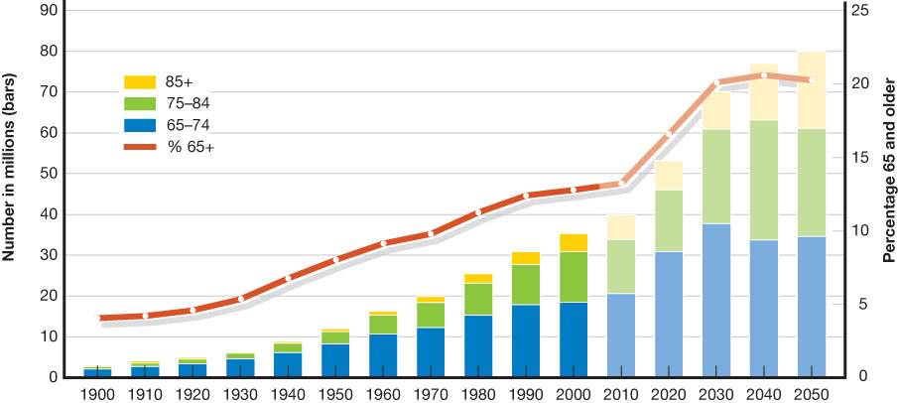
Figure 3.1 Growth of the Elderly Population by Age Group,
1900–2050 (number and percent)
Essentials Of Sociology, 3rd Edition
Copyright © 2011 W.W. Norton & Company

Slide 19
Aging in the United States
One interesting approach to studying aging is to compare the process across societies.
In the United States, the elderly sometimes suffer from feelings of social isolation and a lack of respect.
They experience prejudice, abuse, and health problems at disproportional rates.
These problems are not universal but rather are related to the values of U.S. culture.
Notes:
Though we pay a certain amount of lip-service to caring for and respecting the elderly in the United States, it seems quite clear that they are, in fact, one of our most vulnerable populations. Many are forced into retirement and some into nursing homes; they lose loved ones; and they are sent into totally new lives at a time when such drastic change may be most difficult.
The elderly experience ageism in the workforce and in social life more broadly. Some older Americans feel quite isolated, and there is concern that due to current social trends—including divorce, for example—that number may well increase over time. For now, most adult children maintain regular contact with their parents, even if they live far apart. Far more troubling at this point is the problem of elder abuse. Elder abuse is a drastically underreported crime and, sadly, happens quite often at the hands of family members and loved ones, including spouses.
In terms of health problems, it is little surprise that the elderly experience more health problems than other age cohorts. One very significant concern lies with how well our ailing health care systems will be able to deal with the very large cohort of baby-boomers as they enter the category of the elderly.
An important point to make here is that these trends regarding the elderly are not universal. Depending on the norms and values—the cultures—of other societies, treatment of the elderly may be far better or worse than it is here in the United States. As with all social norms and behaviors, we learn how to treat the various members of our society.
That wraps up our lecture on socialization. Next we will be talking about social interaction and symbolic interactionism.

Slide 21
Clicker Questions
1. What are the main agents of socialization in contemporary society?
a. family, schools, the political system, the economic system, and the urban system
b. family, schools, peer groups, the mass media, and work
c. movies, videos, computers, and the internet
d. newspapers, magazines, radio, and television
21
Notes:
Answer: B
Ref: How Are Children Socialized?, pp. 73–75

Slide 22
Clicker Questions
2. George Herbert Mead's ideas have formed the basis of which general theoretical approach in sociology?
a. symbolic interactionism
b. Marxism
c. functionalism
d. postmodernism
Notes:
Answer: A
Ref: How Are Children Socialized?, p. 71

Slide 23
Clicker Questions
3. What role does socialization play in individual freedom?
a. Learning the value of freedom is a critical aspect of being socialized in American culture.
b. Socialization teaches children the proper limits of freedom—when to play and when to obey.
c. Socialization is essential to our sense of self-identity and our capacity for independent thought and action.
d. Socialization teaches children that life in a consumer society is an endless menu of choices and that, although choosing is difficult, it must always be done quickly.
Notes:
Answer: C
Ref: How Are Children Socialized?, pp. 76–77

Slide 24
Clicker Questions
4. Which of the following statements about gender socialization is correct?
a. Images of females outnumber those of males in the majority of children's literature.
b. While some storybooks today portray females as main characters, few depict boys in non-traditional roles.
c. According to recent research, boys and girls today are equally likely to show no gender preferences when selecting toys with which to play.
d. Parents are aware that they treat male infants differently than female infants.
Notes:
Answer: B
Ref: How Are Children Socialized?, pp. 77–79.

Slide 25
Clicker Questions
5. Which of the following best captures the definition of the life course?
a. the end of life, old age, and death—or when life has run its course
b. the physiological changes associated with aging
c. the daily routines necessary for maintaining physiological and social subsistence
d. the various transitions individuals experience during their lives
Notes:
Answer: D
Ref: What Are the Five Major Stages of the Life Course?,

Slide 26
Clicker Questions
6. What is the demographic change that will likely alter our society’s definition of the life course in the next fifty years?
a. The population will become younger as the proportion of children increases.
b. The population will become more middle-aged as the proportion of adults increases.
c. The population will become older as the proportion of the elderly increases.
d. The population will become more predominantly female as the proportion of men continues to decline.
Notes:
Answer: C
Ref: What Are the Five Major Stages of the Life Course?, pp. 82–83

Slide 27
Clicker Questions
7. Jean Piaget's theory of child development is based on
a. the stages of cognitive development.
b. the emergence of a sense of self, of self-awareness.
c. the importance of sociobiology.
d. the importance of psychopathology.
Notes:
Answer: A
Ref: How Are Children Socialized?, p. 71

Slide 28
Art Presentation Slides
Chapter 3
Socialization, the Life Course, and Aging
Anthony Giddens
Mitchell Duneier
Richard P. Appelbaum
Deborah Carr

Slide 29
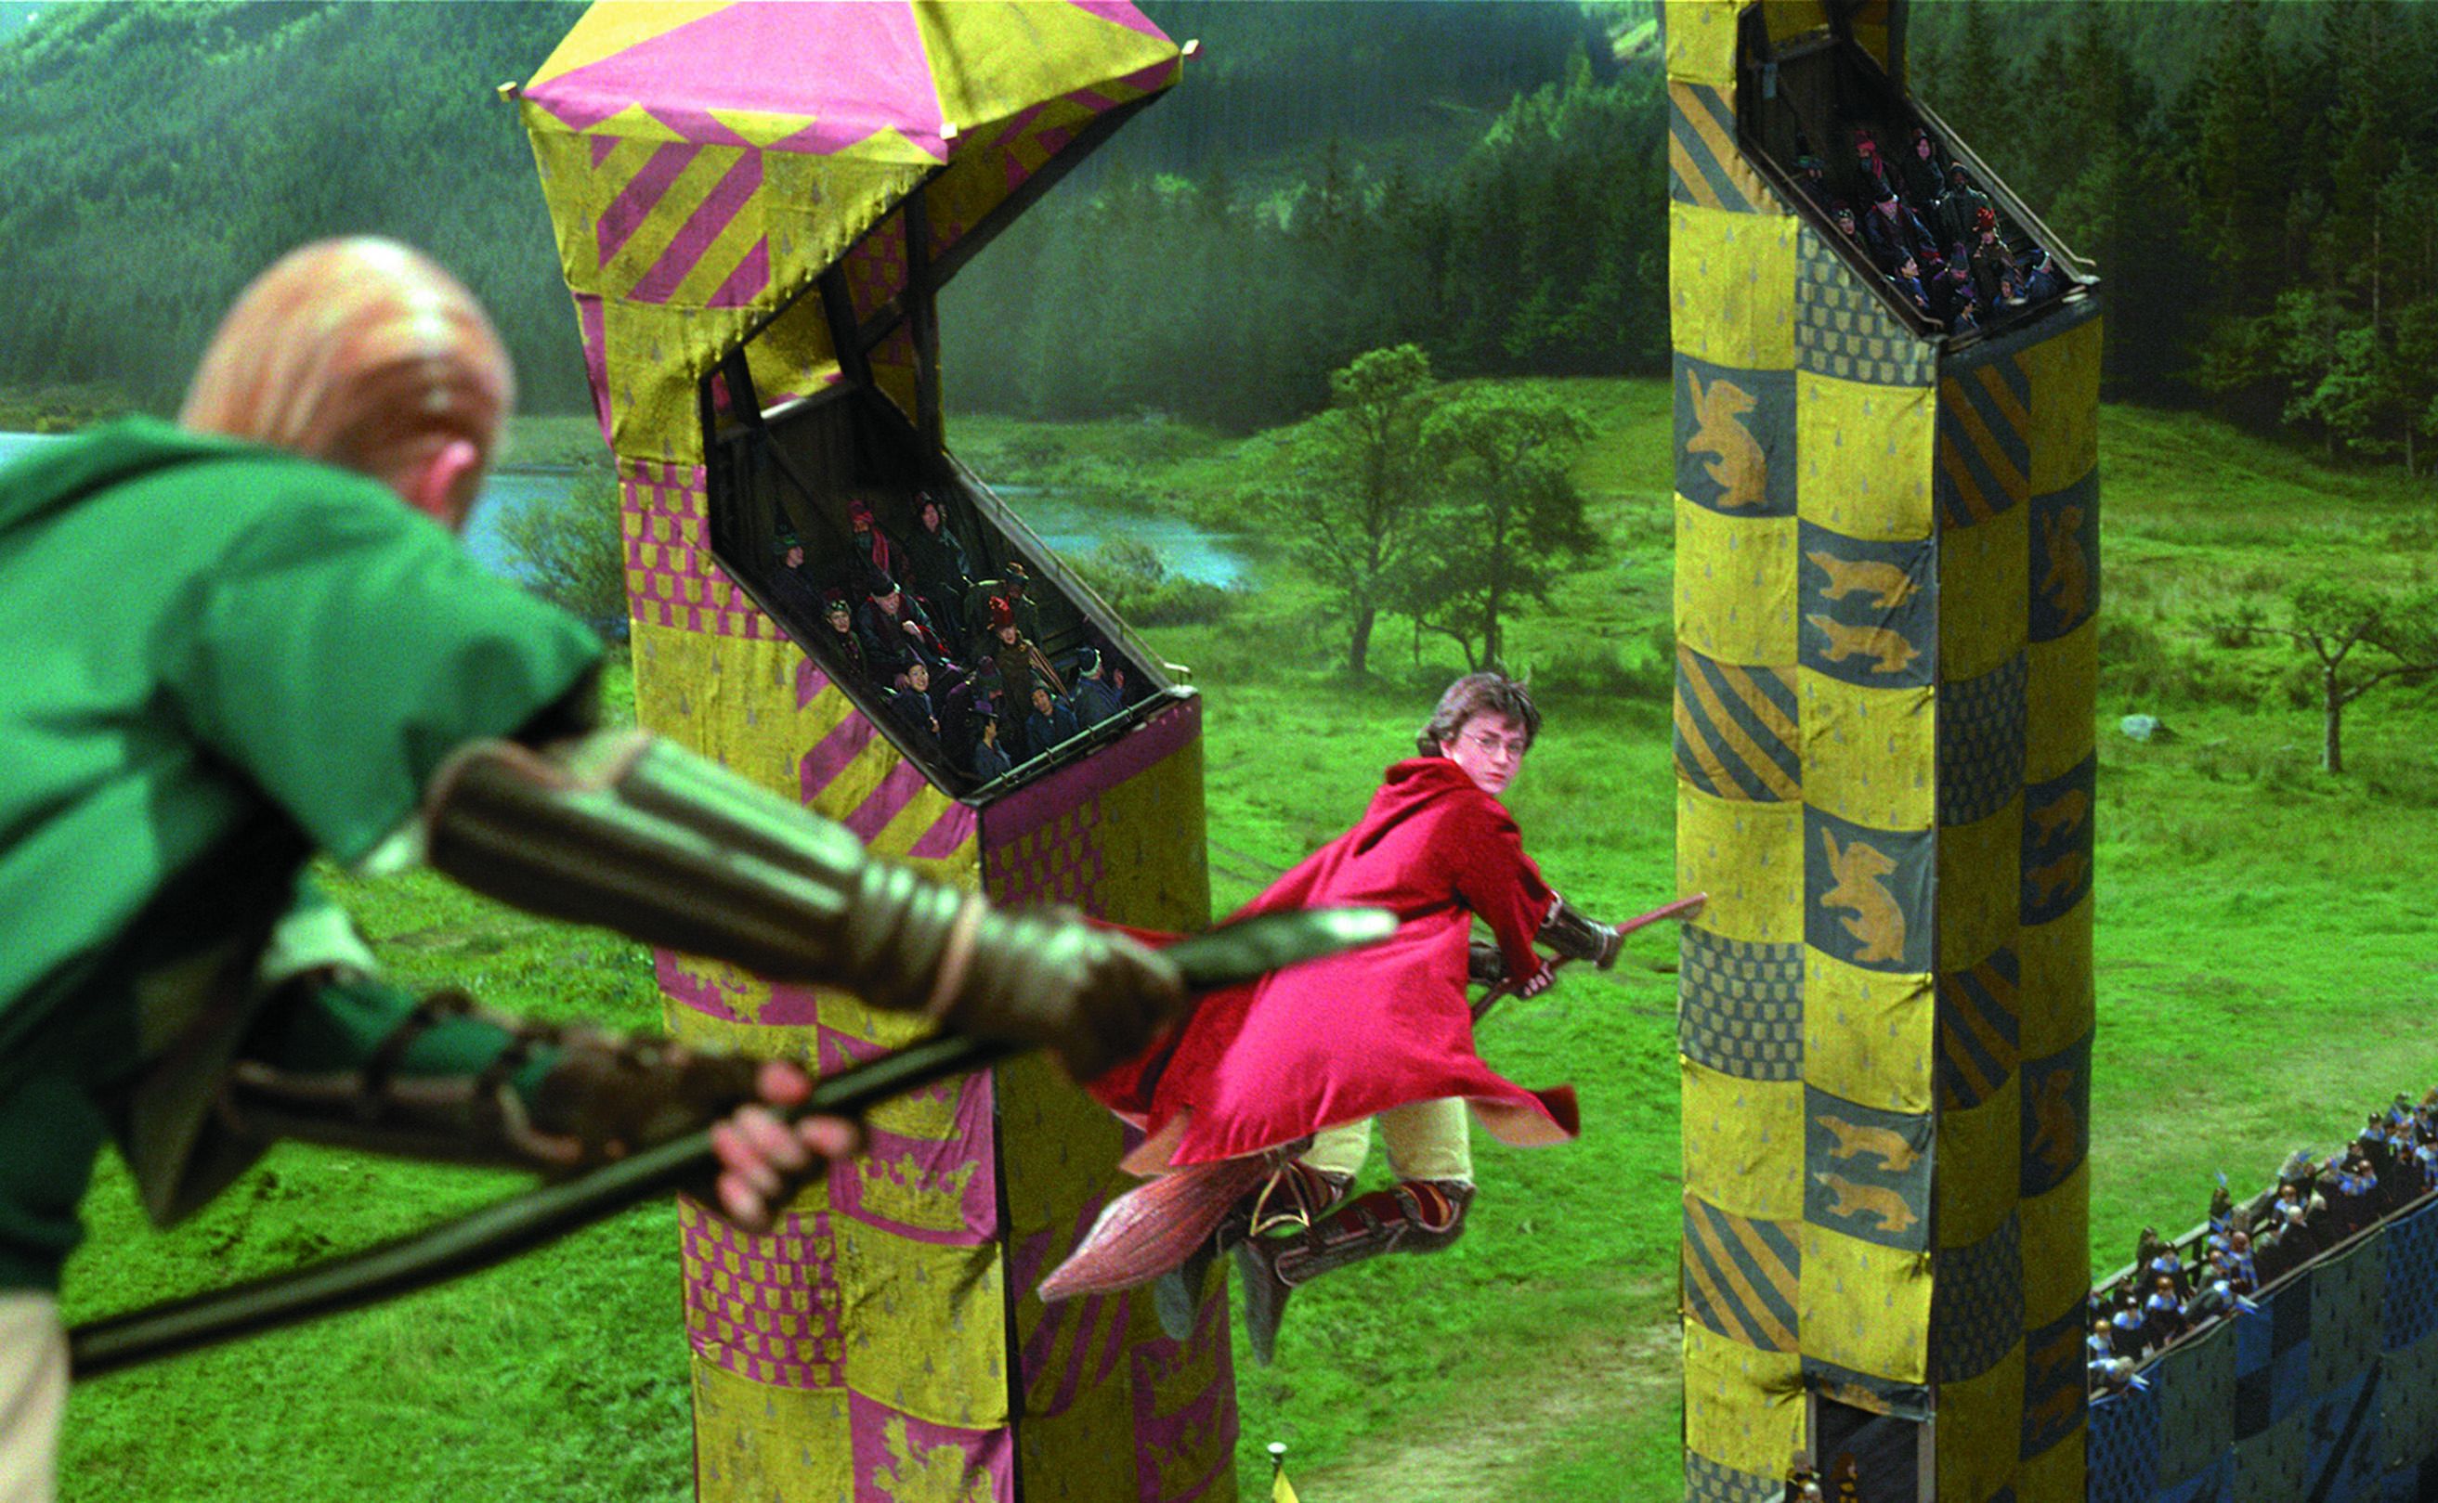
Chapter Opener
Essentials Of Sociology, 3rd Edition
Copyright © 2011 W.W. Norton & Company

Slide 30
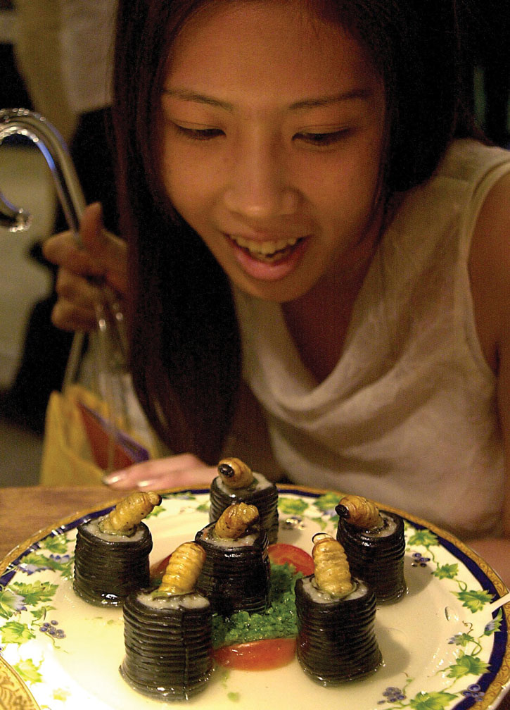
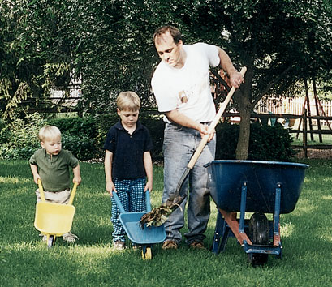
Using their toy wheel barrows to help their father with the
gardening, these boys are, according to Mead, “taking on
the role of the other” and achieving an understanding of
themselves as separate social agents.
Essentials Of Sociology, 3rd Edition
Copyright © 2011 W.W. Norton & Company

Slide 31
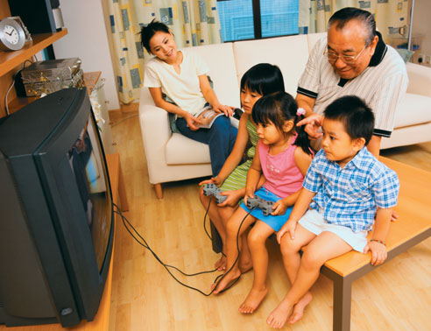
Video games have become a key part of the culture
and experience of childhood today.
Essentials Of Sociology, 3rd Edition
Copyright © 2011 W.W. Norton & Company

Slide 32
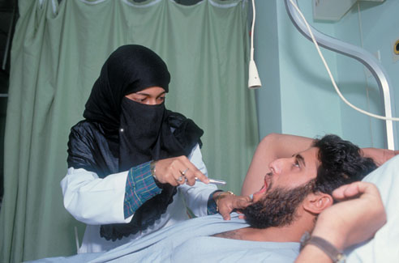
People often exhibit multiple social identities simultaneously
sometimes seemingly conﬂicting ones.
Essentials Of Sociology, 3rd Edition
Copyright © 2011 W.W. Norton & Company

Slide 33
In her “Pink & Blue” project, photographer JeongMee
Yoon records girls’ obsession with the color pink.
Essentials Of Sociology, 3rd Edition
Copyright © 2011 W.W. Norton & Company

Slide 34
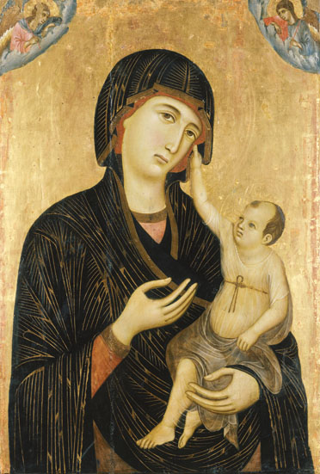
This Madonna and Child, painted in the thirteenth
century by Duccio da Buoninsegna, depicts the infant
Jesus with a mature face.
Essentials Of Sociology, 3rd Edition
Copyright © 2011 W.W. Norton & Company

Slide 35
Globalization and Everyday Life
Essentials Of Sociology, 3rd Edition
Copyright © 2011 W.W. Norton & Company

Slide 36
Globalization and Everyday Life
Essentials Of Sociology, 3rd Edition
Copyright © 2011 W.W. Norton & Company

Slide 37
Figure 3.1 Growth of the Elderly Population by Age Group,
1900–2050 (number and percent)
Essentials Of Sociology, 3rd Edition
Copyright © 2011 W.W. Norton & Company

Slide 38
W.W. Norton & Company Independent and Employee-Owned
This concludes the Art Presentation Slides
Slide Set for Chapter 3
Essentials Of Sociology
THIRD EDITION
by
Anthony Giddens
Mitchell Duneier
Richard P. Appelbaum
Deborah Carr

