Slide 1
European Colonies in the Americas (Part II)
[1450-1750]

Slide 2
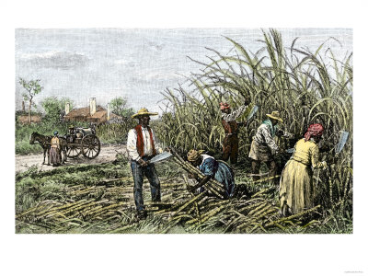
Slaves in the Sugar Colonies
Worked under horrendous conditions
These conditions + diseases = very high death rate
About 5-10% of slave population died per year
Required the continuous importation of fresh slaves from Africa

Slide 3
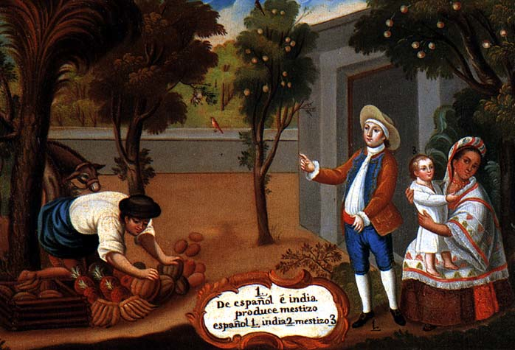
Racial Mixing
Considerable amount of racial mixing also took place in the Caribbean and Brazil
Ex: By 1790 = 93% of the population of Haiti was either partially or wholly of African descent
Ex: Mulattoes = became a major group in Brazil
Product of Portuguese-African unions

Slide 4
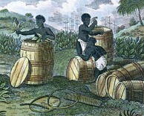
Plantation Colonies in North America
Existed in the southern colonies of North America
Controlled by the British
Major crops grown = tobacco, rice, cotton, and indigo
Painting of a Tobacco Plantation
in Colonial Virginia

Slide 5
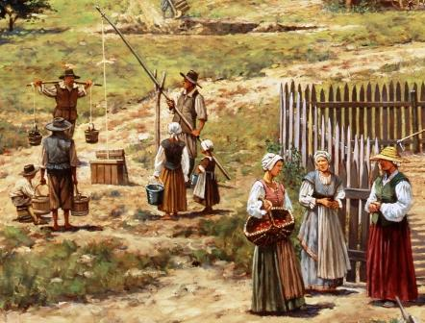
Racial mixing in North America
Very uncommon
Major reason = many European women had migrated to North America along with men, unlike in Central and South America
Result = evolution of sharply defined racial system
Offspring of mixed-race unions = viewed as illegitimate
Any African ancestry made a person “black,” not some other mixed-race category

Slide 6
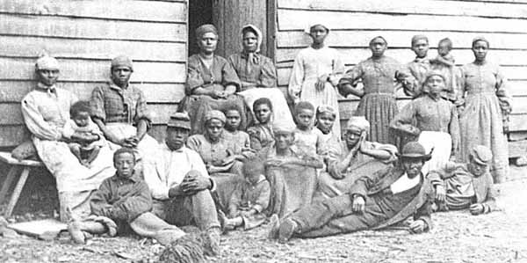
Slavery in North America
Somewhat less harsh than in the sugar colonies
Result = slave population was able to sustain itself and reproduce
No need to constantly import fresh slaves, like in the sugar colonies
By the time of the Civil War = almost all North American slaves had been born in the Americas

Slide 7
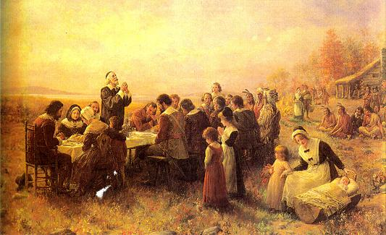
Settler Colonies in North America
Colonies = in New England, New York, and Pennsylvania
Controlled mainly by the British
British settlers sought to escape aspects of the old European society, not to recreate it like the Portuguese and Spanish
Wanted religious freedom
Wanted opportunities for wealth
Colonial Pilgrims on Thanksgiving

Slide 8
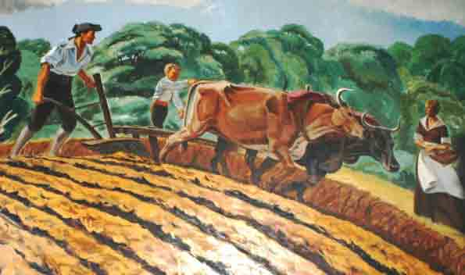
Settler Colonies in North America
Agricultural economies run by small-scale independent farmers working their own land
No slaves needed; though sometimes present occasionally in the households of the wealthy
Pure settler colonies; no racial mixing

Slide 9
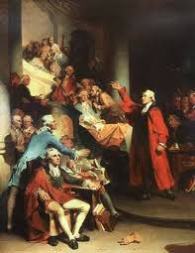
Settler Colonies in North America
Established traditions of local self-government
In Britain = King and parliament involved in a long power struggle
So they paid little attention to the internal affairs of the colonies
Colonies set up their own assemblies

