Slide 1
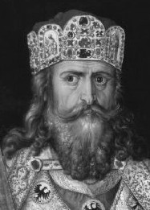
Germanic Kingdoms Emerge & Charlemagne
The Middle Ages

Slide 2
Germanic Kingdoms Emerge

Slide 3
Germanic Kingdoms Emerge
Germanic Kingdoms
In the upheaval between 400 and 600, small Germanic kingdoms replaced Roman provinces
Borders changed constantly
Family ties and personal loyalty were more important than public government and written law
Germanic stress on personal ties made it impossible to establish orderly government

Slide 4
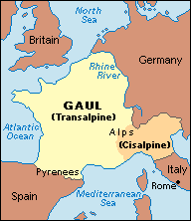
Germanic Kingdoms Emerge
Clovis and the Franks
The Franks had power in Gaul (modern day France and Switzerland)

Slide 5
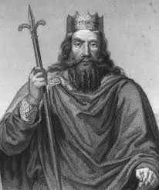
Germanic Kingdoms Emerge
Clovis was leader of the Franks
Clovis brings Christianity to the region
Fears defeat by another Germanic tribe and appeals to Christian God:
Battle shifts in his favor and Franks win
Clovis and 3,000 of his warriors ask a bishop to baptize them
By 511, Clovis had united the Franks in one kingdom

Slide 6
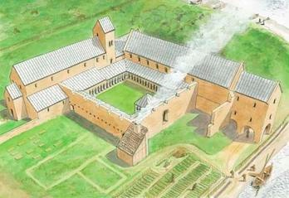
Germanic Kingdoms Emerge
Christianity
Christianity was a constant variable
Monasteries provided education and a place to serve god for men
Convents for women (nuns)
The church was extending its influence into politics and everyday life
The power of the pope was rapidly expanding

Slide 7
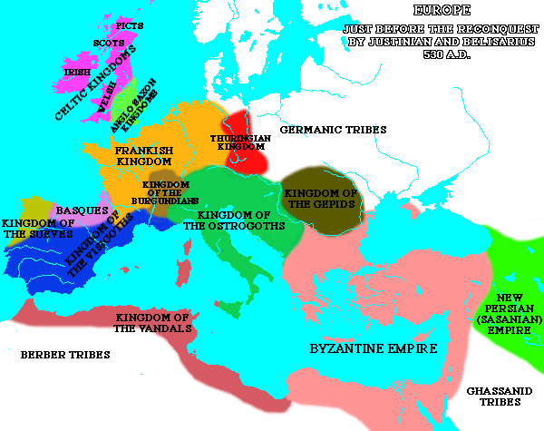
Germanic Kingdoms Emerge
An Empire Evolves
After the fall of Rome, small kingdoms popped up all over Europe
Franks controlled the largest and strongest of Europe’s kingdoms
When Clovis died in 511, the Franks controlled most of modern day France

Slide 8
Germanic Kingdoms Emerge
Mayor of the Palace:
Position which had become the most powerful in Frankish kingdom
Official power: Had charge of the royal households and estates (like a lord)
Unofficial power: Led armies and made policy, essentially ruling the kingdom

Slide 9
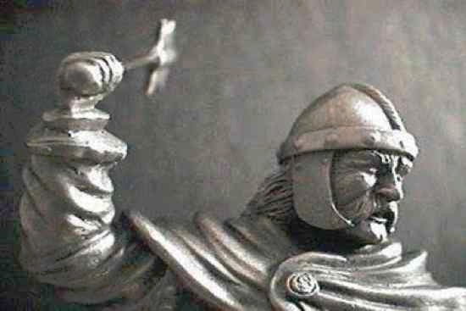
Germanic Kingdoms Emerge
Charles Martel or Charles the Hammer
By 719, Charles held more power than the king

Slide 10
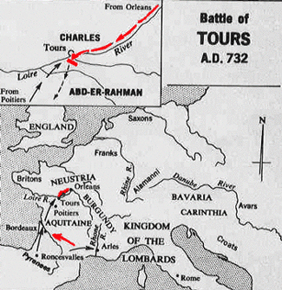
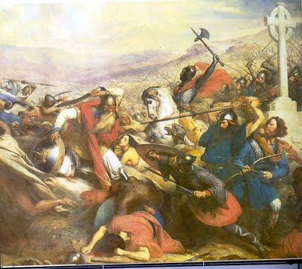
Germanic Kingdoms Emerge
Charles Martel or Charles the Hammer
Defeated Muslim raiders from Spain at the Battle of Tours in 732
Victory was highly significant for European Christians, Charles was a Christian hero (lose battle, lose Europe?)
At his death, he passed his power to Pepin the Short
Pope anoints Pepin “King by the grace of God,” thus beginning the Carolingian Dynasty- family that would rule the Franks from 751-987

Slide 11
Charlemagne

Slide 12
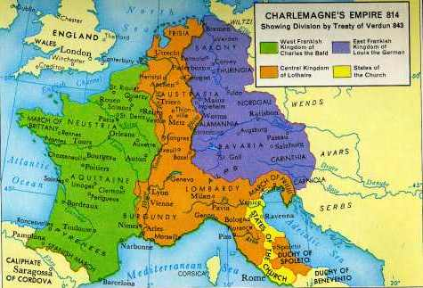
Charlemagne
Charlemagne Becomes Emperor
Pepin the short died in 768
Charles the Great, better known as Charlemagne takes over in 771
Imposing figure standing 6 foot 4 inches tall
Charlemagne built an empire greater than any known since ancient Rome

Slide 13
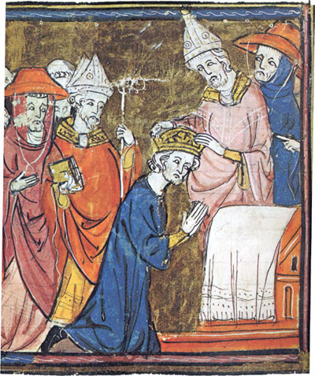
Charlemagne
His conquests against the Muslims and to the south and east spread Christianity
He reunited Western Europe for the first time since the Roman Empire
Was now the most powerful king in western Europe
In 800, he traveled to Rome to protect the pope → the pope rewards Charlemagne by crowning him emperor

Slide 14
Germanic Kingdoms Emerge
Charlemagne as King
Charlemagne strengthened his power by limiting authority of the nobles
Sent out royal agents to check on powerful landowners
Regularly visited his kingdom
Encouraged learning- surrounded himself with scholars and opened new monasteries
Charlemagne died in 814, his sons split up the kingdom- bad idea- Carolingian kings lost power and authority broke down
This lead to the rise of feudalism

Slide 15
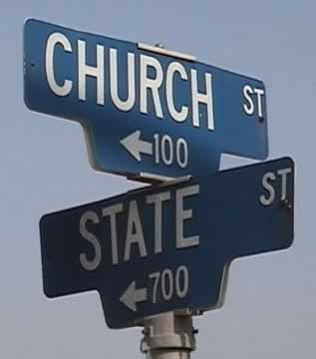
Germanic Kingdoms Emerge
Result: Historic coronation, which gave the pope the right to confer the title of Roman Emperor on European kings. Signaled the joining of Germanic power, the Church, and the heritage of the Roman Empire.

