Slide 1
Chapter 9: Gender Inequality
Notes:
How many of you think often about what it means to be a man or a woman? And about how gender is constructed in our daily lives?
Most of us don’t think terribly often about these things; we take our own gender for granted and assume it is simply part of who we are.
Today, we’ll take a sociological approach to thinking about gender, and I suspect some of what I have to say may seem strange. That’s okay, and in fact that is part of the point of looking at things from a new angle.

Slide 2
Overarching questions
Is gender biological, social, or both?
Why is power invested in the male category?
What does gender inequality look like and why?
Why is gendered violence so commonplace?
Notes:
There are many big questions that need to be addressed as begin our conversation about gender and gender inequality. To begin, we need to think about gender as sociologists: is gender biologically determined, socially constructed, or some combination? We need to ask the “elephant in the room” question: why is it that in the vast majority of human societies, men have had more power than women? Once we consider that question, we can begin asking questions about what inequality looks like and what its effects are. This includes, for example, exploring the relative normality of violence against women.

Slide 3
Sex and gender
As sociologists we begin by separating sex and gender:
  Sex is a biological category.
  Gender is a social category.
3
Notes:
So let’s get down to business. The first thing to know when thinking about gender and gender inequality sociologically is that we separate sex and gender. We’ll get to the biologically basics in a minute, but first follow me. Sex is a biological category determined by chromosomes, hormones, genes, and so on. Gender is a set of roles and actions that is influenced by numerous social factors and by biology.

Slide 4
Biological differentiation
Chromosomes
  XX and XY
  XXY or XYY can occur in rare cases
Hormones
  Estrogen and testosterone
The question: How important is biology in explaining behavioral differences?
4
Notes:
Biologically, we typically think of only two sexes, male and female. In terms of chromosomes, this means that each human being has either two X’s or an X and a Y; we are all either female or male. In rare cases, however, there are those who have either XXY or XYY, thus muddying the waters and causing a great deal of anguish for individuals and families who are forced to deal with gender uncertainty. We also tend to think of hormones as telling us a great deal about someone’s gender (and gendered behaviors), with estrogen being a female hormone and testosterone a male hormone. It turns out we all have some of both. And though men typically have more testosterone and women more estrogen, those amounts vary. Additionally, the amounts can be altered based on behaviors. What this tells us is that biology is not as clear as we’d like to imagine.
The question that remains is how much biology explains in terms of explaining gender and gendered inequality? It explains some, but since—at least in the case of hormones—it can be subject to external influences, we know biology does not tell us everything we need to know.

Slide 5
Socialization and environment
Gender roles are learned via socialization, both early on and throughout life.
Gender socialization now begins prior to birth.
Varying social environments produce different versions of “man” and “woman.”
Gender is socially constructed.
5
Notes:
As sociologists, we think it critical to emphasize the important explanatory value of adding social factors to questions looking to explore gender.
Sex is a genetic determination—chromosomes. Yes, there are rare cases of sexual ambiguity, but by and large chromosomes are a clear marker of biological sex. Gender, on the other hand, refers to role expectations and socialization.
By role expectations, I mean the kind of behavior that is expected of someone identified to be, in this case, male or female. For example, commercials that show women doing all of the cooking and cleaning in the home and men at work and playing sports, and driving trucks clearly illustrate roles that are seen as normal for men and women.
By socialization, I mean in particular the way children learn what kinds of behaviors, activities, and ways of presenting themselves are acceptable for their sex. That is, I mean the way they learn gender. For example, we buy dolls for girls and trucks for boys. This process actually begins before children are even born; just think about what goes in to planning a baby’s nursery.
In other words, sex is biological, while gender is social and cultural.

Slide 6
Language and gender socialization
The language we use is not gender neutral; it is part of everyday life.
Much language glorifies the male category and demeans the female.
Notes:
One of the most persistent ways we are socialized is via language. Language is part of everyday experience is social life, and language is far from neutral. In fact, there are patterns of language that consistently reinforce gender inequality in ways that we rarely think about. Consider, for example, these harmless poems from childhood:
“What are little boys made of?
Snips and snails and puppy dog tails . . .”
“What are little girls made of?
Sugar and spice and everything nice . . .”
This usage certainly makes clear distinctions between boys and girls, however harmless it seems. And many of the distinctions found in language have serious repercussions.

Slide 7
Gendered language
Janet Shibley Hyde notes patterns in gendered language:
  Male as normative/female as exception
  Parallel words
  Infantilization of women
Allowing language to devalue women and girls is part of socialization and contributes to inequality.
7
Notes:
Hyde, a psychologist, has noted the presence of multiple patterns of what she calls gendered language. Three examples of these patterns are male-as-normative, parallel words, and the infantilization of women. Let’s quickly think of examples of each:
Male-as-normative/female-as-exception: chairman of the board, fireman, basketball team and women’s basketball team. What is the effect of this?
Parallel words: bachelor-spinster, master-mistress, others? What are the connotations of these different words?
Infantilization of women: calling adult women “girls,” “honey,” and “sweetie,” even in places of business. What is the effect of this?
The effect is significant. The phenomenon of belittling male performance with feminine attributions is seen throughout the sporting world as well, with male players being called “girls” or “woman” for underperforming or being emotional. Terms like “throw like a girl” or “where’s your skirt?” have become part of our vernacular. Though we tend to wave off such name-calling as unimportant, let’s think back to Hyde’s argument about the importance of language.
The key here is that to allow the use of feminine terms to represent weakness or poor performance is to devalue females. This happens all day, every day, and is internalized by both boys and girls.

Slide 8
Doing gender
Gender is more than simply a learned role, though that role is important.
Gender is something to be done—accomplished—each day.
Notes:
Ethnomethodologists remind us that as important as learning and developing gender roles may be, being a man or a woman goes beyond that. Gender is something that we must all enact—and that we usually enact successfully—each and every day.

Slide 9
Gender in time and space
Gender has not always looked the same:
  Consider changes in gender roles over the past 50–100 years here in the United States.
Gender does not look the same across cultures:
  Mead’s research in New Guinea (1930s) showed significant variation between tribes and with outside cultures.
Notes:
Two ways we can be very clear on the fact that gender is social, are looking at changes in the meaning of gender across time and looking at variation in the meaning of gender across social space (in different societies).
Consider changes over time. In the past 50–100 years, the roles women inhabit have shifted dramatically across social life. The majority of adult women now work outside the home. Women can vote, run for national office, divorce their spouse, and file for marital rape. Men can choose (though not many do) to stay home with the children. And that’s just the tip of the iceberg.
The same kind of variation is true looking at different countries today. Surely what it means to be a proper woman is not the same in the United States as it is in most Middle Eastern countries. It’s not even the same in all regions of the United States. Margaret Mead, the famous anthropologist, showed that this kind of variation also existed between tribes in New Guinea in the 1930s.
The point is that gender is not static: It is influenced by the social. If it were purely biological, it would look the same across time and space.

Slide 10
Gender in time and space
Gender is not always confined to male and female.
  Example: the Zuni berdache
10
Notes:
One of the seemingly solid truths about gender, from a Western perspective, is that there are only two: male and female. But as it turns out—and this is another example of the ways that gender can look different in different societies—this is not necessarily so. In some societies, the culture includes a third gendered space, known as a berdache. A berdache is a person of one gender who embodies the other, but is not doing so for reasons of sexuality. Your textbook gives the example of the Zuni, a Native American tribe that incorporates a berdache group, whose constituents may be homosexual, heterosexual, or may be attached to other berdache. Again, this kind of variation is simply illustrative of the role of culture in determining what constitutes gender.

Slide 11
Gender systems
Patriarchy refers to the gender system in societies where men are dominant.
Nearly all societies are patriarchal, though the degree varies greatly.
Gender inequality refers to the difference in power, status, access, and choices between men and women.
11
Notes:
Now that I’ve established that gender can look different in different spaces, let’s think about what gender systems look like. Broadly speaking such systems are matriarchal or patriarchal, meaning that either women or men are dominant, respectively. In practice, though some cultures are partially matriarchal, the vast majority of human societies have been, and are, patriarchal. The degree to which this is true varies a great deal—again, think of the changes here in the United States over the past century—but patriarchy has been the dominant gender system in settled human history.
A significant part of patriarchy is the ongoing presence of gender inequality, such that men and male roles are privileged over women and female roles. Men, as a rule, have more power, more status, more access, and more choices than women. It is important to note that just because men and women are doing different things does not preclude equality. But, if those different things are valued differently, such that those things typed male are routinely given greater value, then we are indeed looking at a system of gender inequality. This is where nearly all societies today stand, again, to varying degrees.

Slide 12
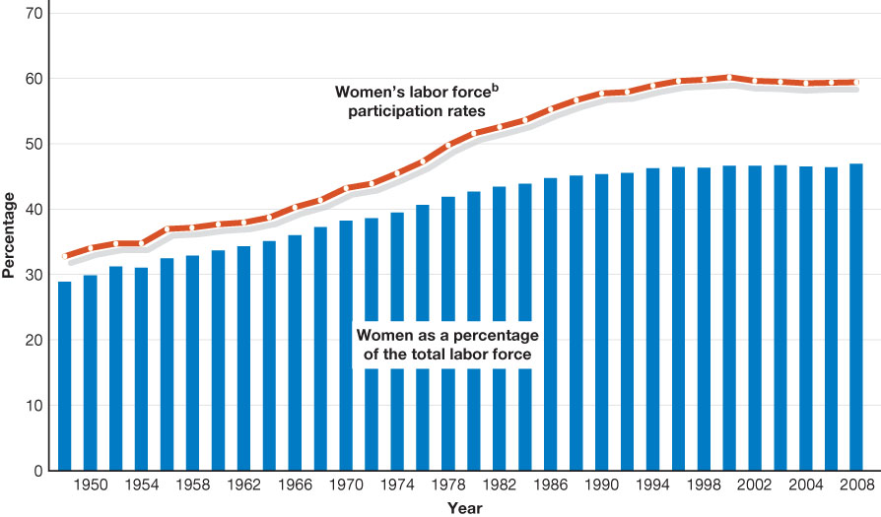
Figure 9.1 Women’s Participation in the Labor Force in
the United States
Essentials Of Sociology, 3rd Edition
Copyright © 2011 W.W. Norton & Company

Slide 13
Inequality at work
Jobs gender-typed female are valued less and paid less.
The gender gap in earnings has narrowed but remains in place (1970–2008).
  FT employees: 62% → 80%
  Hourly: 64% → 79%
  All employees: 46% → 61%
Notes:
Just because women have entered the workplace, however, does not mean that gender inequality has gone out the door. I’m going to talk about five big issues that continue to be a problem for women.
First is the issue of gender-typing. Gender-typing occurs when certain kinds of jobs are considered male or female. Some are obvious: Housekeepers are female and garbage collectors are men. Other jobs are less obvious, but typing remains: Bankers are men, doctors are men, lawyers are men, teachers are women, social workers are women, nurses are women. Of course there are many women who are doctors and men who are teachers, but the jobs are associated with one gender. Why is this a problem of equity? Because jobs typed as female are valued less and paid less than jobs typed as male, and this is true around the world and has been for a long time (see George Murdoch 1937).
Second, we have the ongoing gender gap in pay. Certainly the gap has closed, as you can see in these figures, but women are clearly still not earning as much as men.
[The numbers on the slide indicate the ratio of women’s to men’s earnings (p. 249 in textbook).]

Slide 14
Inequality at work
Informal structures such as the glass ceiling and glass escalator reproduce gender inequality by favoring male employees.
Sexual harassment also continues to be a way for men to dominate women in the workplace.
14
Notes:
A third issue, which has been an attempt to remedy the pay gap by changing the devaluation of women’s work, has been the institutionalization of comparable worth policies. These policies try to rank and then equalize the pay of male- and female-typed jobs, looking at objective measures of skill, responsibility, risk, and other such factors. Obviously this is incredibly hard to do in practice, and in addition, some economists worry over negative, unintended consequences.
A fourth set of issues include the long-discussed glass ceiling and the newer concept of the glass escalator. The glass ceiling is an informal structure that seems to keep women from reaching the upper levels within organizations. The glass escalator is also an informal structure whereby men in female-typed fields seem to be propelled to the upper reaches in large numbers. Though the glass ceiling has been broken in some cases, when you look at the fairly small numbers of female chief executive officers (CEOs) of top companies, it is clearly still in place: in 2005 only two Fortune 500 companies had female CEOs.
And finally, a fifth problem of gender inequality at work is that of sexual harassment. There are two kinds of harassment to consider: one occurs when a supervisor demands a quid pro quo, and the other involves the creation of a hostile work environment. This does happen to men, as well as women, but the vast majority of the time it is women who are the victims—since it is typically men who are in the positions of power, this should be no real surprise.

Slide 15
Gender and family
The ongoing difficulty of balancing work and family rests largely on women.
  Managers see women as more tied to family than work.
  This affects women’s ability to get responsible positions.
Women also continue to do significantly more housework than their spouses.
Notes:
Another way that work and gender interact is in the connection to family. Although men participate much more in the home than they did in earlier times, it is still women who do the majority of domestic work. Because of this, women not only feel more conflicted and more pulled in different directions, their employers assume this work-home conflict will be a problem and as a result pass over women when making promotions. This long-standing pattern of women doing most of what is often called the “second shift” (Hochschild) makes it hard for them to advance now that they have entered the workforce.

Slide 16
Gender and education
Differential treatment in schools perpetuates traditional gender socialization.
  More attention—positive and negative—is paid to boys.
But something is changing: Today girls outperform boys on many measures.
Notes:
Obviously, the labor force is not the only major social institution where we see gender inequality. In education today we see a very mixed bag. We know from years of research that boys and girls are treated differently in the classroom, mostly in favor of boys. Even so, that attention also means more punitive as well as positive time. What we also know, though, is that in recent years, girls have outperforming and out-graduated boys. Colleges now typically have a majority of female students. So what is happening? There is a great deal of research underway to explore this change.

Slide 17
Gender and politics
In the United States, men outnumber women at all levels of political office, but especially at the state and national levels.
Globally, some thirty-eight countries have had female heads of state (not including the United States), but in 2009 women made up only 18 percent of national parliaments (legislatures).
17
Notes:
Another place where we see continued inequality is in the political realm. While there is no question that we have come a long way from having no women in public office at all, there are still fewer women than men at every level of the U.S. government. Perhaps more troubling is the fact that this is more true the higher up we go; perhaps politics can boast the ultimate glass ceiling. So far, here in the United States, we haven’t even had a female nominee for president. Many countries have had women as head of state, but women are still significantly underrepresented in national parliaments (legislatures).
What are the ramifications of this disparity? In concert with the lack of female leadership in corporations and other organizations, it means that patriarchy retains its hold at the highest levels.

Slide 18
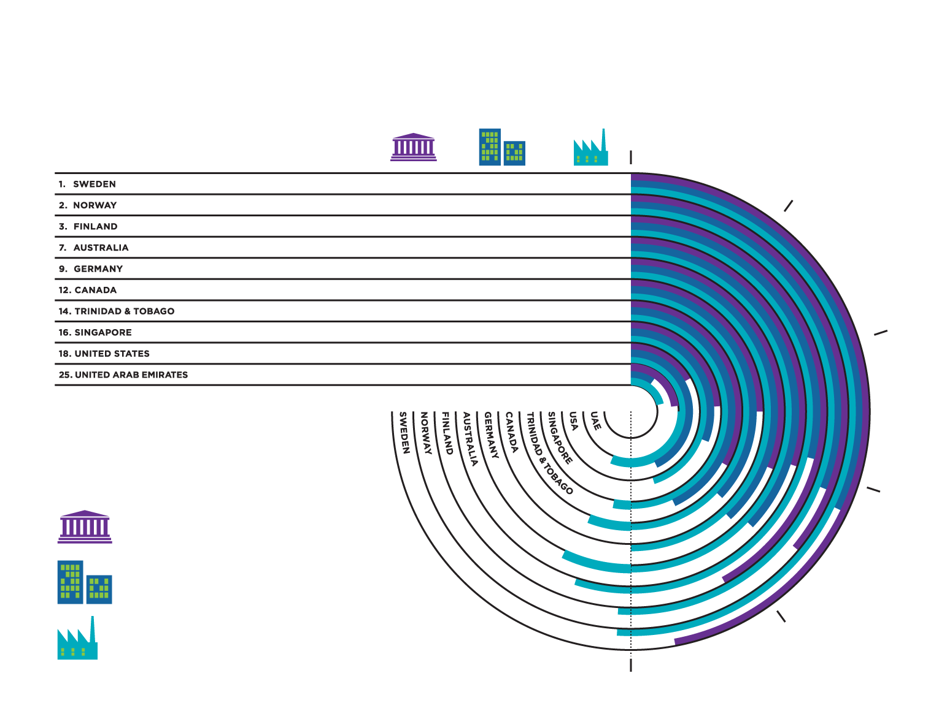
Gender Empowerment Around the World
Year Women Could Vote
Income Ratio
Essentials Of Sociology, 3rd Edition
Copyright © 2011 W.W. Norton & Company
0%
1919
1913
1906
1902
1918
1917
1946
1947
1920
2006
0.67
0.77
0.73
0.59
0.65
0.65
0.55
0.53
0.79
0.27
47%
36%
42%
30%
31%
25%
33%
24%
17%
23%
32%
31%
29%
37%
38%
37%
43%
31%
43%
10%
51%
51%
55%
57%
50%
56%
53%
45%
56%
21%
10%
20%
Ten Countries
Ranked by Gender Empowerment Measure
30%
% of Seats in Parliament
% of Legislators, Senior Officials, & Managers
% of Professional & Technical Workers
40%
* Ratio of estimate female to male earned income SOURCE: UNDP 2009a.
50%
18
Notes:
Infographic exercises:
Which three countries have the largest percentage of women holding seats in parliament? How are these three countries related to each other?
Which of the three “gender empowerment measures” has a female participation rate of over 50 percent?
In what year were women in the United Arab Emirates given the right to vote?
What is the income ratio (i.e., the ratio of estimated female to male earned income) in the United States? Does this mean that the United States has high or low gender empowerment?
In what two countries do women make up 43 percent of legislators, senior officials, and managers?

Slide 19
Violence against women
Violence against women is institutionalized in varying ways around the world.
  Dowry disputes in India
  Sharia law in Islamic countries
  Foot-binding in China
  Genital mutilation in many countries
  Forced prostitution (sex trafficking)
  Culture of misogyny
19
Notes:
A less data-driven measure of gender inequality is the way in which violence against women which continues the world over. Sadly, violence against women is so common that it is correct to say that it is, in fact, normal. You are likely all familiar—at least in theory—with such practices as food-binding, genital mutilation, and sex trafficking, and it is fairly easy to agree that these things are wrong. Although we here in the United States are vocally against physical violence against women, we still harbor a culture of misogyny that sometimes silently, sometimes more explicitly reinforces male power and female victimhood. All it takes is time spent observing our popular culture to see that our culture both reflects and reproduces long-standing power structures. There are exceptions, but their very presence as something new or different seems to prove the rule.

Slide 20
Rape
Nearly one-quarter of women say they have been forced into a sexual encounter, but only 3 percent of men acknowledge coercive sex.
College campuses are a prime location for sexual violence and attempted sexual violence.
  Rape
  Coercion
  Stalking
20
Notes:
This culture of misogyny seems to also play out in the sexual behaviors of Americans, especially young people. Rape, sexual coercion, and stalking have become, not far-off possibilities, but real events that college women are taught to prepare for and prevent against. Colleges are now one of the central sites of sexual violence. Of course, they are not the only places. Women face coercion and violence in many social locations. There are varying statistics, but some suggest that as many as one of five of women will experience sexual violence in her lifetime.

