Slide 1
Islam & Cultural Encounters

Slide 2
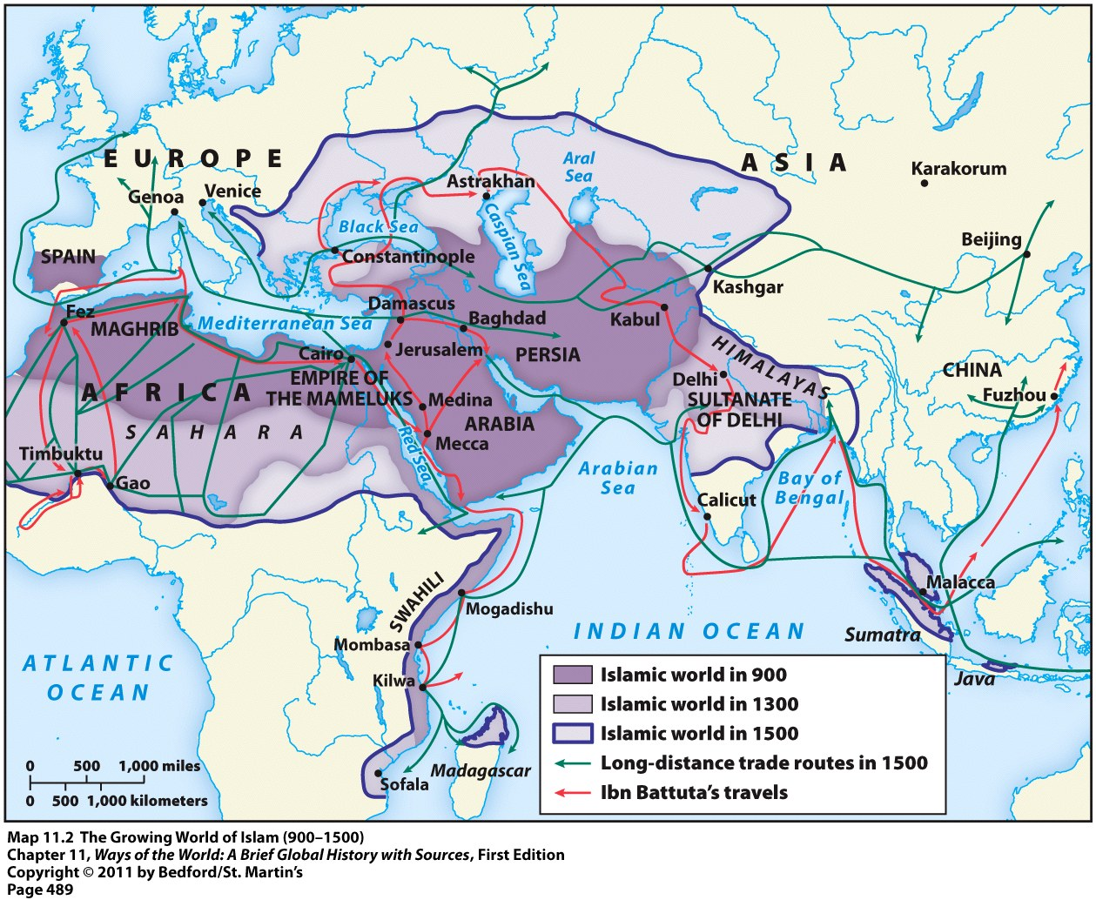
The Islamic Civilization
Even after the Arab Empire fell apart, the Islamic civilization continued to grow
Major areas of Muslim expansion: India, Anatolia, West Africa, and Spain

Slide 3
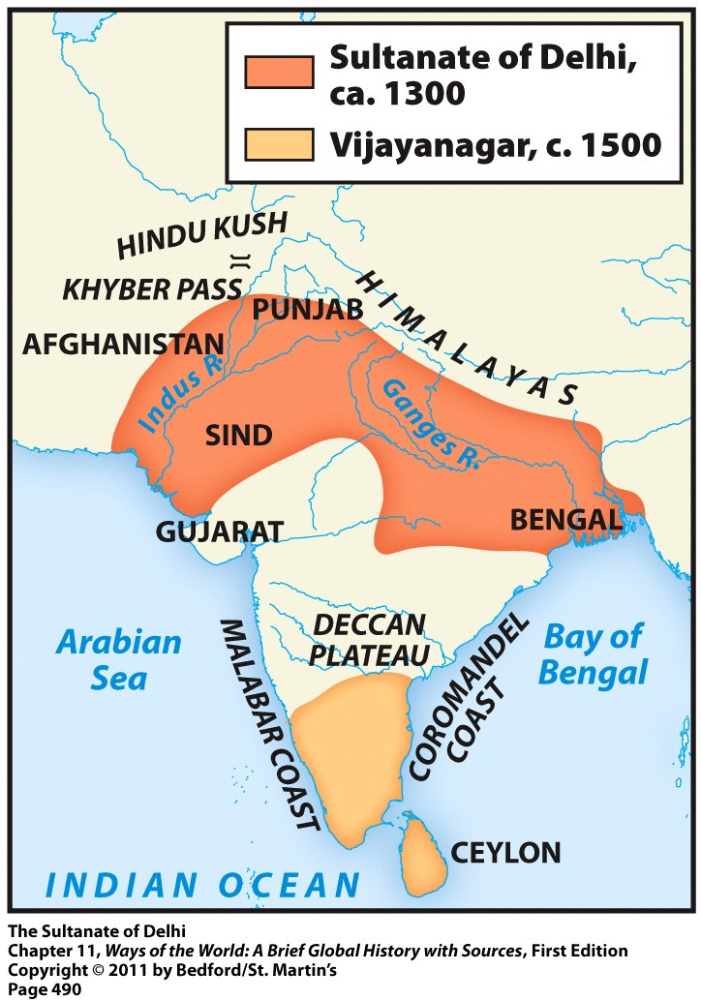
India
Islam brought to India by Muslim Turks from Central Asia
Violent invasions → destruction of Hindu and Buddhist temples
Their conquests led to a series of Muslim-led governments in India

Slide 4
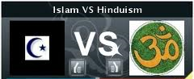
India
Islam never became the dominant faith in India like it did in the Middle East, North Africa, and Persia
Very sharp cultural divide between Islam and Hinduism → prevented mass conversion

Slide 5
Islam vs. Hinduism
Monotheistic
No representation of Allah
Equality of all believers
Sexual modesty
Polytheistic
Endless statues and images of the divine
Caste system
Sexual openness

Slide 6
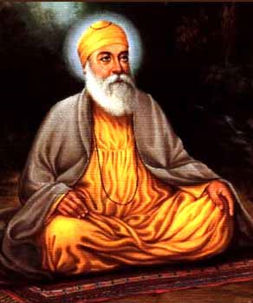
Sikhism
Founded in the 15th Century or 1400s
20 million followers present day mostly in the Punjab region of India as well as the U.S. and U.K.
Sikhism is a monotheistic religion
Sikhism stresses the importance of doing good actions rather than merely carrying out rituals
Sikhs believe that the way to lead a good life is to:
keep God in heart and mind at all times
live honestly and work hard
treat everyone equally
be generous to the less fortunate
serve others
Sikhs try to avoid the five vices that make people self-centred, and build barriers against God in their lives.
Lust
Covetousness and greed
Attachment to things of this world
Anger
Pride
Hindu concepts = karma and rebirth
Guru Nank
Founder of Sikhism

Slide 7
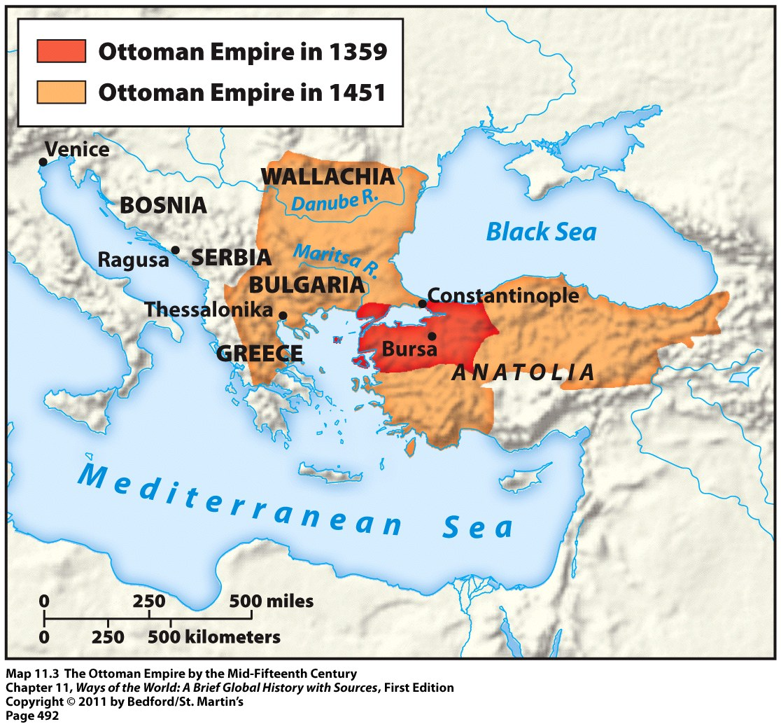
Anatolia
Modern-day Turkey
Was governed by Byzantine Empire at the time
Filled with Christian & Greek-speaking people
Invaded by the Turks
Result = huge cultural transformation
By 1500 = 90% of the population was Muslim and Turkic-speaking

Slide 8
Conversion of Anatolia
Small population of about 8 million people = easy to convert
Extensive disruption of Anatolian society when the Byzantine Empire weakened
Enslavement, famine, massacres, church properties destroyed, many discriminations
Many people converted to Islam during this time of uncertainty in Anatolia

Slide 9
Conversion of Anatolia
Cultural barriers to conversion were less severe in Anatolia than in India
Most people in Anatolia already monotheistic (Christian)
Muslim respect for Jesus and the Christian scriptures
Divide between Islam and Christianity not as major as the one between Islam and Hinduism
Sufi missionaries also built: schools, mills, orchards, hospices, and rest places for travelers

Slide 10
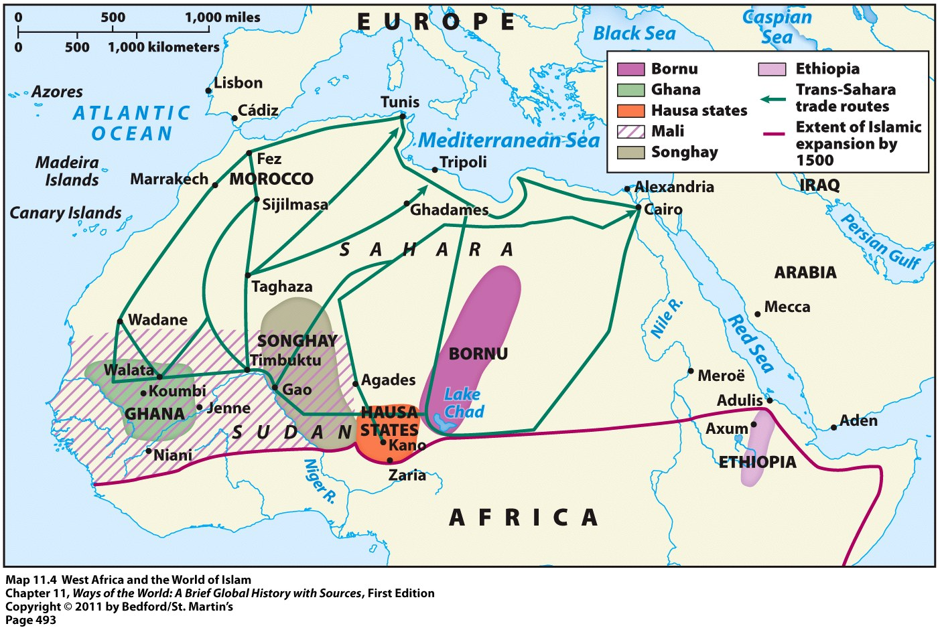
West Africa
Islam spread by Muslim traders across the Sahara
Peaceful and voluntary acceptance of Islam
Mainly in urban centers of West African empires → Ghana, Songhay, Mali, etc.

Slide 11
West Africa
Many West African cities became major centers of Islamic religious and intellectual life
Especially Timbuktu
More than 150 Quranic schools
Several major centers of higher education
Libraries with tens of thousands of texts
Construction of huge mosques
Adopted Arabic as the language of religion, education, administration, and trade

Slide 12
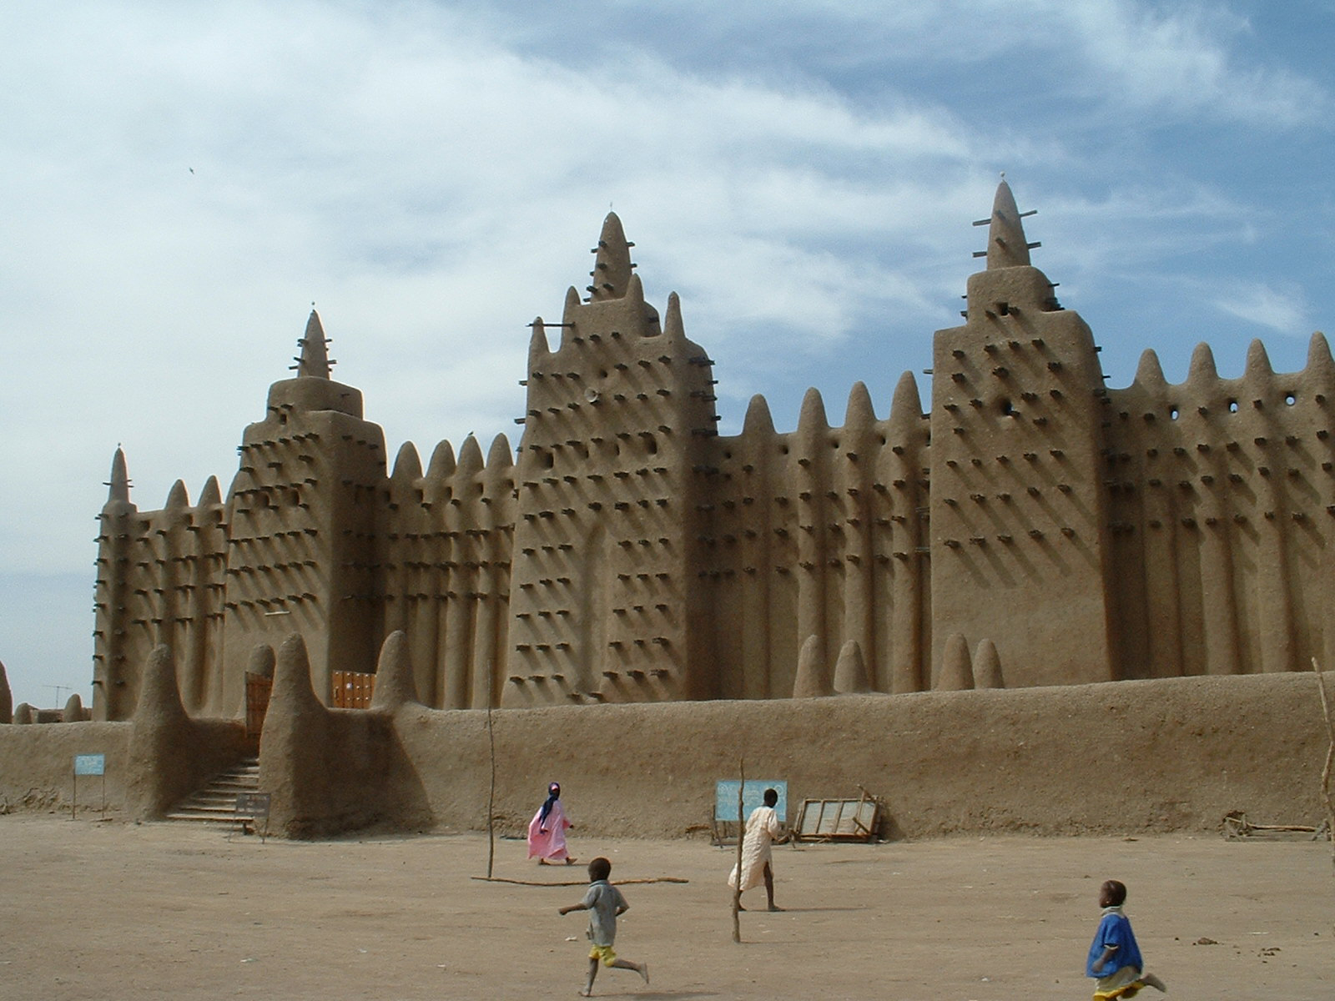
Great Mosque at Jenne

Slide 13
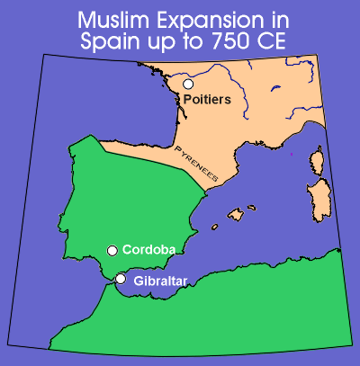
Spain
Conquered by Arab and Berber forces in the early 700s
Early Muslim Spain:
Vibrant civilization
Astronomy, medicine, the arts, architecture, and literature flourished
Harmony and tolerance between Muslim rulers and Christian and Jewish subjects
Freedom of worship

Slide 14
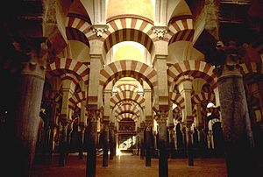
Spain
10th and 11th centuries = end of the era of toleration
Warfare with remaining Christian states in northern Spain picked up
More rigid forms of Islam entered Spain from North Africa
Muslim Mosque of
Cordoba, Spain

Slide 15
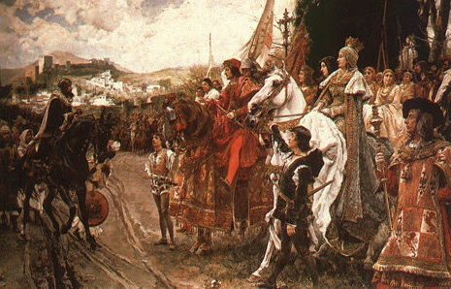
Spain
Christians started to regain Spain after 1200
Many Muslims forced out
No more: call to prayer, public practice of Muslim faith, pilgrimages
Christians officially reconquered Spain in 1492
ALL Muslims expelled from Spain

Slide 16
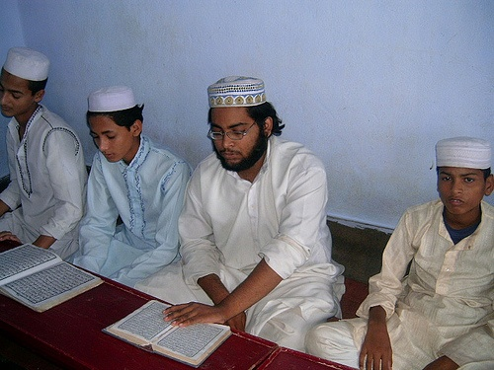
Islam as a New Civilization
Even after the fall of the Arab Empire: Islamic beliefs and practices preserved and transmitted by the ulama (Muslim scholars)
Passed on core teachings of the faith in their homes, mosques, shrines, and Quranic schools
Madrasas = formal colleges set up in the 11th century = offered more advanced instruction in the Quran

Slide 17
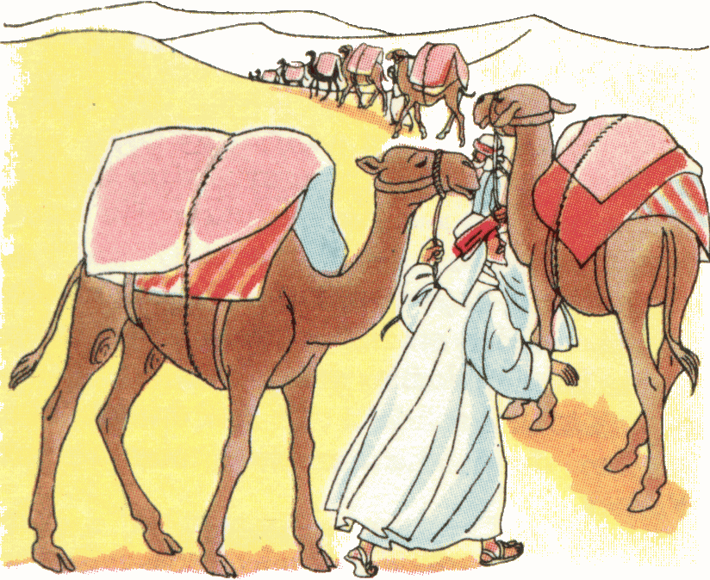
Islamic Civilization
Islamic Civilization = not only a network of faith, but also a network of exchange
Exchange of: goods, technologies, food products, and ideas

Slide 18
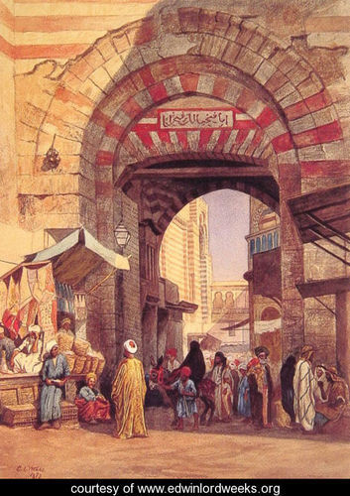
Trade and the Bazaar
Muslims traded spices, carpets, glass & textiles
Traded for silk (China); rubies (India); ivory and slaves (Africa)
Goods were sold in city bazaars = marketplaces

Slide 19
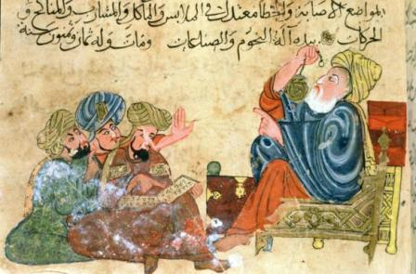
The House of Wisdom
Founded by the caliph al-Mamun
Was a research center in Baghdad
Scholars translated texts from Greek, Persian & Indian into Arabic
Performed scientific experiments

Slide 20
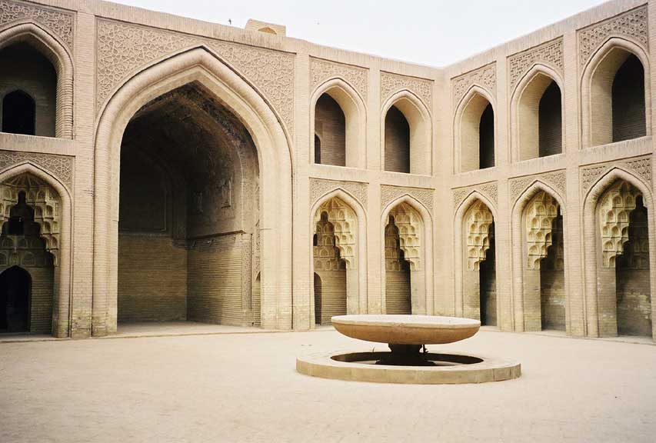
House of Wisdom

Slide 21
Mathematics
Invented algebra & equations for curves and lines

Slide 22
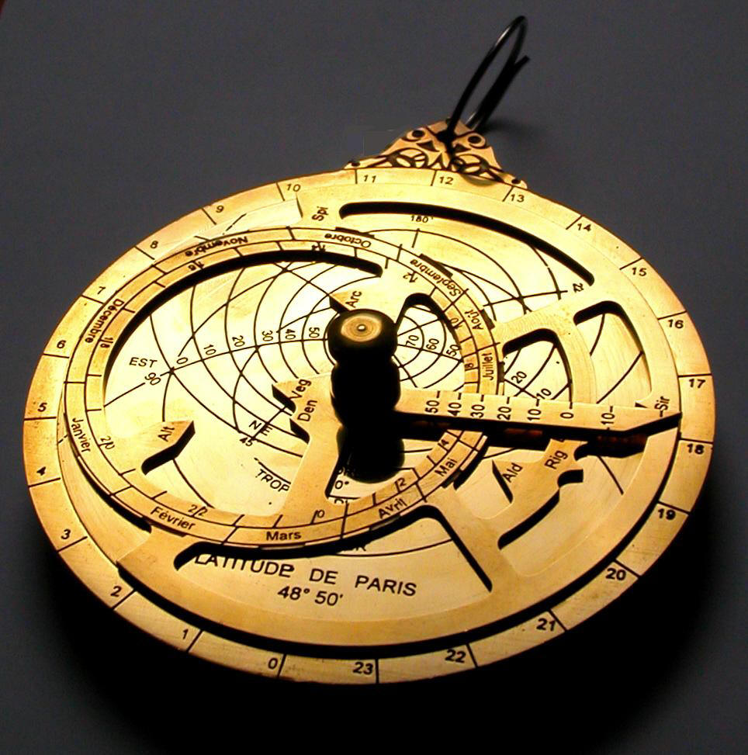
Astronomy & Geography
Improved the Greek astrolabe = determines the position of the stars, the movement of the planets, and the time
Astrolabe made navigation easier and safer

Slide 23
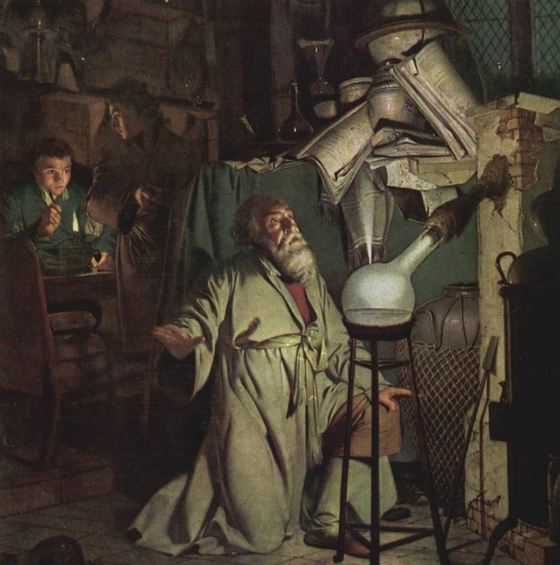
Chemistry
Developed alchemy = attempting to turn lead into gold
Al-Razi classified chemical substances as animal, mineral, or vegetable
Created the science of optics = study of light & its effects on sight

Slide 24
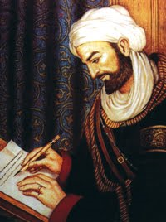
Medicine
Physicians al-Razi and Ibn Sina = accurately diagnosed many diseases
Hay fever, measles, smallpox, diphtheria, rabies, diabetes
Arab doctors started:
Hernia operations
Cataract operations
Filling teeth with gold
Ibn Sina

