Slide 1
Maurya
&
Gupta
India

Slide 2
Division of India
Before 3rd C. BCE Politically fragmented due to:
Terrain (Mountains, valleys, forests, steppes, deserts)
Led to different languages & cultural beliefs
Transportation and communication difficult
Caste system
Hundreds of jati separated people

Slide 3
The Caste System of India~ The Caste system of Ancient India is the system of social standings and social restrictions on people in Ancient India. Nobody knows how or when the Caste System was created, but one main theory is that it developed around the time that the Aryans conquered India. It is said that the Aryans divided the people of the region into five groups. They then placed themselves into the top three groups, what are today the Brahmins, Kshatriyas and the Vaisya. The fourth group was known as the Sudra, reserved for the conquered people of the region. During the development of the Caste System, a fifth group, known as the Untouchables were created. All five groups combined created the entirety of the Caste System. The most powerful group, called the Brahmins, were all powerful. Teaching, studying, sacrificing for himself, sacrificing for others, making gifts and receiving them are the six acts prescribed for a Brahmin. The next group, called the Kshatriyas, were the leaders of the military. The third most powerful group, the Vaisya, were responsible for trading. TheSudra, were responsible for physical labor, and contained people who worked as artisans. Finally, the "Untouchables" are the lowest of the low, a group sometimes not even associated with the Caste System. The "untouchables" were responsible for sewage cleaning and the "dirty work" of an area. These five groups were known as varnas, with many subgroups based on kinship called jatis in each varna.

Slide 4
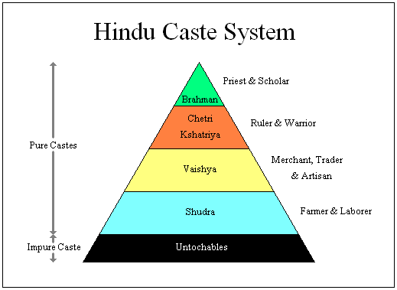

Slide 5
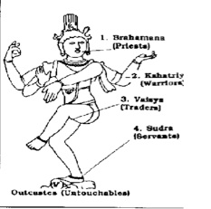

Slide 6
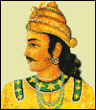
Chandragupta Maurya:
Maurya Empire: 321 BCE-184 BCE
Unified northern India.
India’s first centralized government
Defeated the Persians
Divided his empire into provinces, then districts for tax assessments and law enforcement.
He feared assassination → food tasters, slept in different rooms, etc.
301 BCE → gave up his throne & became a Jain.

Slide 7
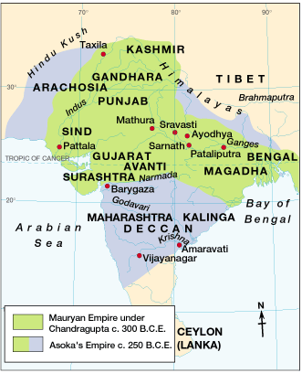
The Maurya Empire
321 BCE – 185 BCE

Slide 8
Focus Questions
Who was Chandragupta Maurya?
Who was Ashoka? Why did Ashoka devote himself to Buddhism?

Slide 9
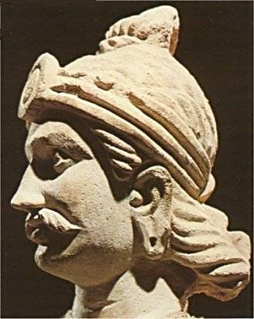
Ashoka (304 – 232 BCE)
Chandragupta’s Grandson
Religious conversion after the gruesome battle of Kalinga in 262 BCE.
Dedicated his life to Buddhism
Emphasis on peace, tolerance, and nonviolence
He restricted slaughter of animals and encouraged vegetarianism
Built extensive roads.

Slide 10
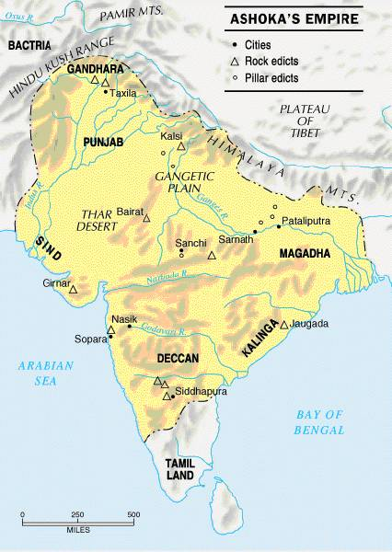
Ashoka’s Empire

Slide 11
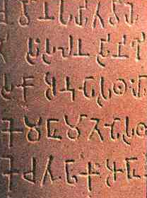
Ashoka’s law code
Edicts scattered in more than 30 places in India, Nepal, Pakistan, & Afghanistan.
Written mostly in Sanskrit, but one was in Greek and Aramaic.
10 rock edicts.
Each pillar [stupa] is 40’-50’ high.
Buddhist principles dominate his laws.

Slide 12
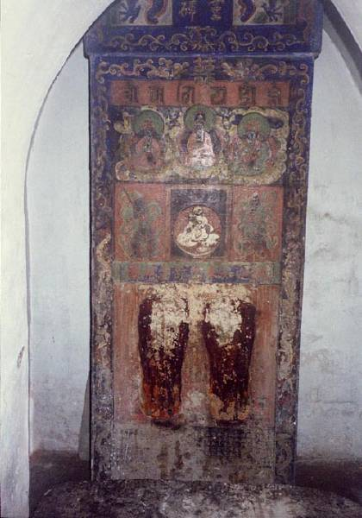
One of Ashoka’sStupas

Slide 13
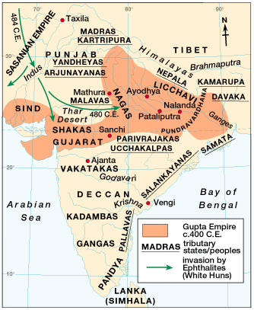
Gupta Empire: 320 CE – 647 CE

Slide 14
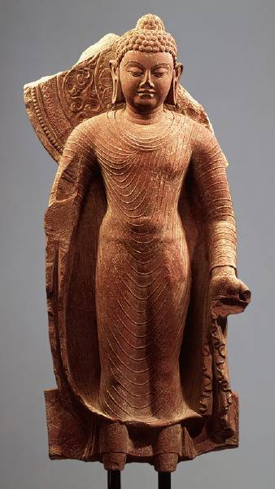
Gupta Rulers
Chandra Gupta I
Modeled himself after Chandragupta Maurya by taking his name
r. 320 – 335 CE
“Great King of Kings”
Chandra Gupta II
r. 375 - 415 CE
Profitable trade with the Mediterranean world!
Hindu revival.
Huns invade – 450 CE

Slide 15
More Gupta
Smaller than Maurya
Never as much control as Ashoka
Drew tribute from subjects, but still allowed regional warlords to rule

Slide 16
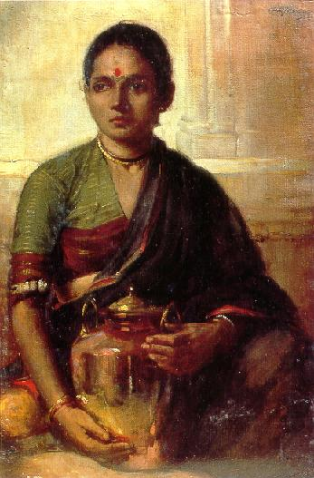
Gender
Men dominated the Aryan world (patriarchal) -
Aryan women had choice of choosing husband;
Indian women could remarry if widowed; took part on social affairs; high ranking boys and girls could attend school; were educated in household tasks
Status of women declines after Aryans arrive
Gupta- women & mothers highly respected, but had little independence

Slide 17
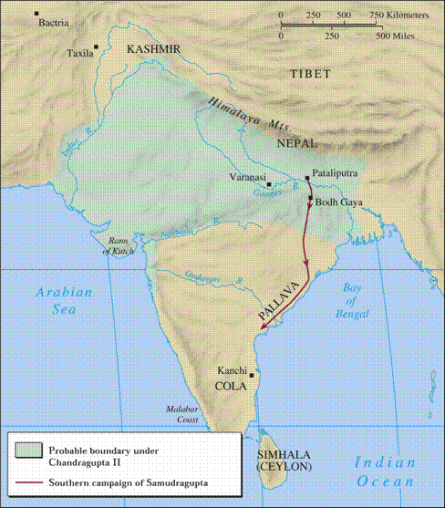
Chandra Gupta II

Slide 18
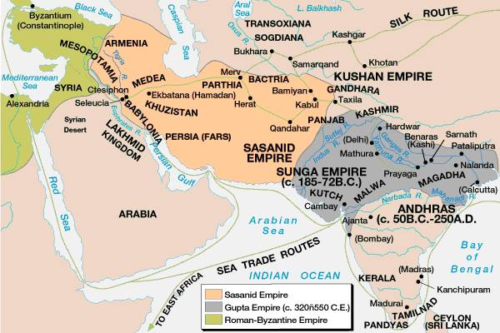
International Trade Routes during the Gupta

Slide 19
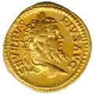
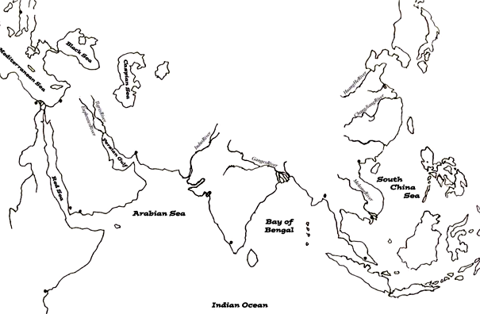
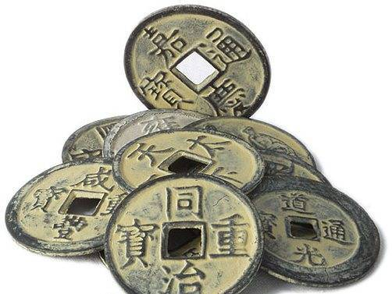
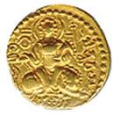
Extensive Trade: 4c
spices
silks
cotton goods
rice & wheat
spices
horses
gold & ivory
gold & ivory
cotton goods

Slide 20
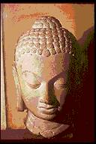
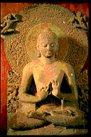
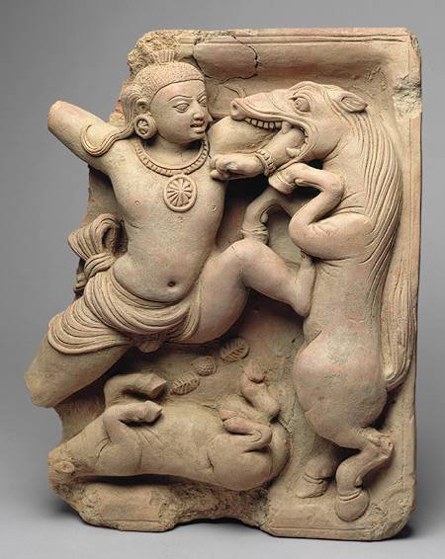
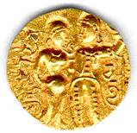
Gupta Art
Greatly influenced Southeast Asian art & architecture.

Slide 21
Gupta Achievements
1000 diseases classified
500 healing plants identified
Printed medicinal guides
Kalidasa
Plastic Surgery
Medicine
Literature
Inoculations
Gupta India
C-sections performed
Solar Calendar
Astronomy
Mathematics
Decimal System
The earth is round
PI = 3.1416
Concept of Zero

Slide 22
The Decline of the Gupta
Invasion of the Huns in the 4c signaled the end of the Gupta Golden Age, even though at first, the Gupta defeated them.
After the decline of the Gupta empire, north India broke into a number of separate Hindu kingdoms and was not really unified again until the coming of the Muslims in the 7c.

Slide 23
Guiding Questions: Maurya and Gupta
What were the major trade goods out of India? Out of Africa?
Describe how the geography of India affects it politically.
What were the Rock Edicts?
What pushed Asoka towards Buddhism.
How did Asoka’s belief in Buddhism affect his people?

