Slide 1
Origins of Islam

Slide 2
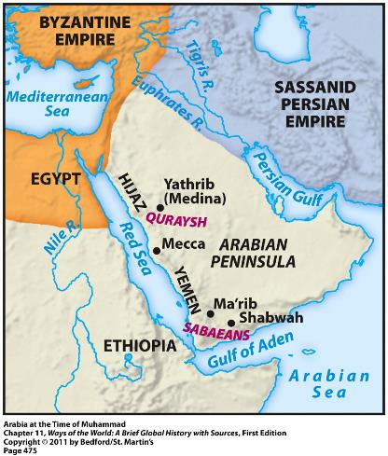
The Origins of Islam
Originated on the Arabian Peninsula
Had long been inhabited by nomadic Arabs = the Bedouins
Located along important trade routes → Indian Ocean, Mediterranean Sea, etc.
Gave rise to large commercial cities with larger urban populations

Slide 3
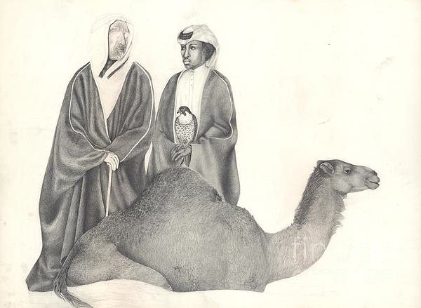
Bedouins
Herded sheep and camels
Lived in fiercely independent clans and tribes
Often engaged in violent wars with each other
Variety of gods and ancestor/nature spirits
Valued personal bravery and group loyalty

Slide 4
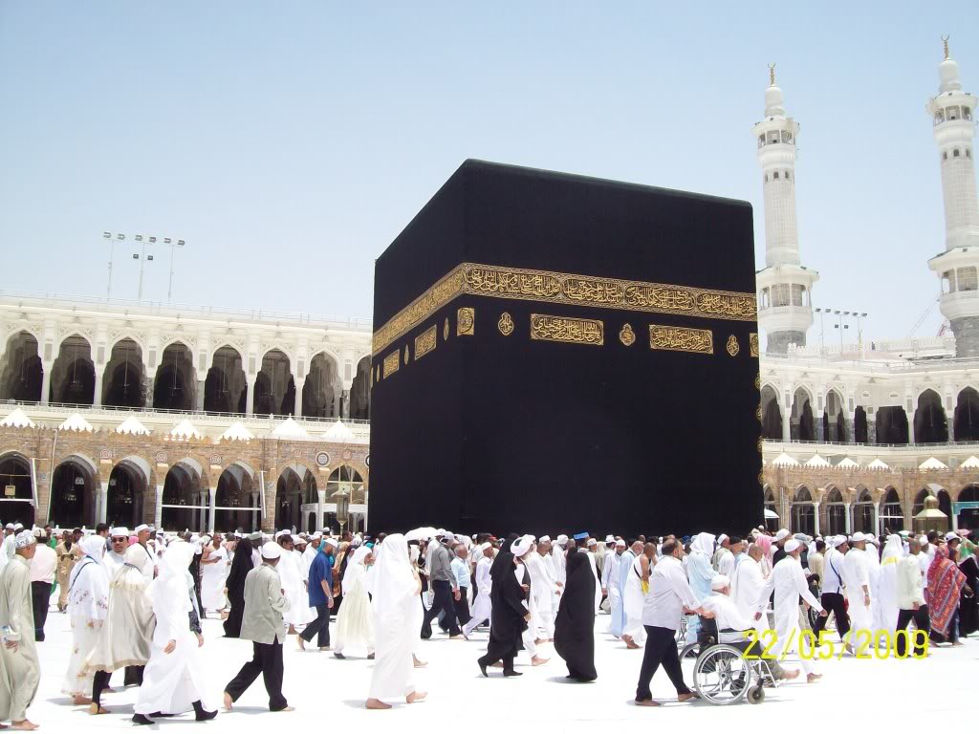
Mecca
Major commercial city
Site of the Kaaba = most important religious shrine in Arabia
Housed representations of about 360 deities
Ruling tribe of Mecca = the Quraysh
Controlled access to the Kaaba
Gained wealth by taxing local trade

Slide 5
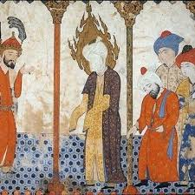
The Messenger
Muhammad (570 – 632 CE)
Born in Mecca
From a Quraysh family
A shepherd and a trader
Troubled by the religious corruption and social inequalities of Mecca
Often withdrew into the mountains to meditate
610 CE = he had an overwhelming religious experience
Message given by the angle Gabriel

Slide 6
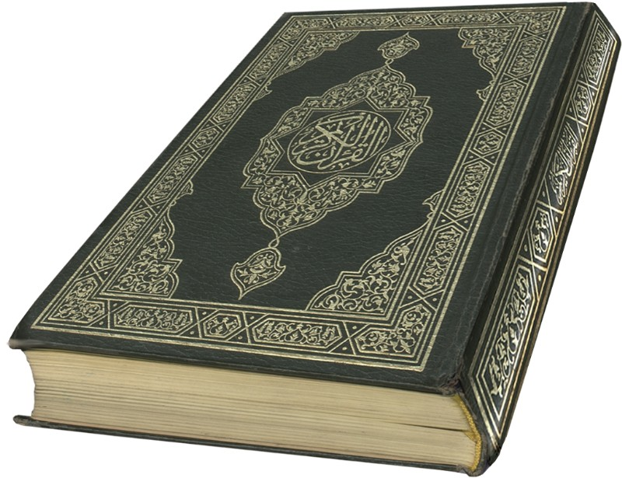
The Message
Muhammad’s revelations began in 610 CE and continued for the next 22 years
Recorded in the Quran = the sacred scriptures of Islam
Monotheistic → Allah is the only God
All-powerful Creator
Good, just, and merciful
Rejected the other deities housed in the Kaaba

Slide 7
The Message
The Quran rejected:
Hoarding of wealth and materialism
Exploitation of the poor
Corrupt business practices
Neglecting widows and orphans
Abuse of women
The Quran demanded:
Social justice
Equality
Aid to the poor

Slide 8
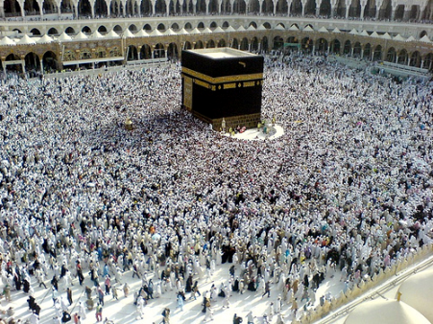
The Message: 5 Pillars of Islam
1) Shahadah- profession of faith
2) Salat- Prayer: Should be performed 5 times daily while facing in the direction of Mecca
3) Zakat- Almsgiving: Supporting the poor and needy of the community
4) Saem-Fasting: Occurs during month of Ramadan; no food, drink, or sexual relations from dawn to sundown
5) The Hajj: Pilgrimage to Mecca

Slide 9
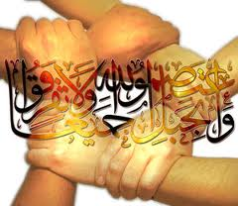
The Message
Umma = the community of all believers
Just and moral society of Islam
Would replace tribal, ethnic, or racial identities
Muhammad develops the first Umma in Mecca but his message of equality and peace will not be accepted by the Bedouin.

Slide 10
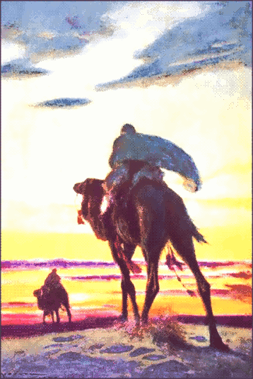
Transformation of Arabia
Muhammad’s message soon attracted opposition from Mecca’s elite families:
Claim to be the “messenger of Allah”
Strict monotheism
Call for social reform
Condemnation of business practices
Disloyalty to his own tribe
Caused Muhammad and his followers to go to Medina (hijrah)
This is where the umma took shape

Slide 11
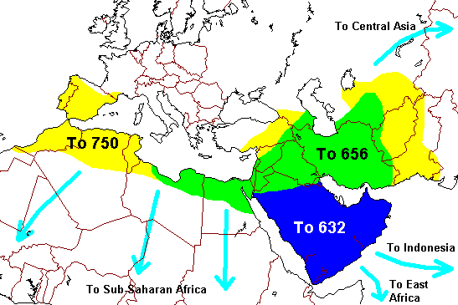
The Islamic Community
Muhammad = both religious and political leader; also led the military
Islamic community expanded throughout Arabia by:
Military conquest
Marriage alliances with leading tribes
Voluntary conversion
By 632 (time of Muhammad’s death), most of Arabia had come under Islamic control

