Slide 1
Communism: A General Overview
Socialism = the belief that the economy should be controlled by society, either directly or through the government
Believe in: a classless society, equal distribution of wealth, gender equality, etc.
How is communism different?
It really isn’t very different → think of communists as “extreme socialists”
Socialists believe their ideal society can be achieved slowly through progression and evolution of the government
Communists believe this society can only be achieved by overthrowing the government

Slide 2
The Russian Revolution (1917)

Slide 3
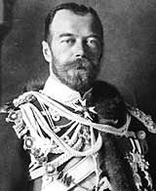
Pre-Revolutionary Russia
Only true autocracy left in Europe
No type of representative political institutions
Nicholas II became czar in 1884
Last ruler from the Romanov family
Believed he was the absolute ruler anointed by God
Russo-Japanese War (1904) = defeat for Russia in this war led to political instability

Slide 4
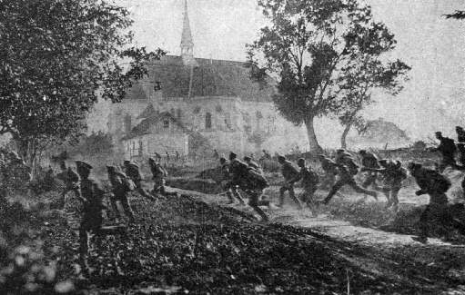
Russia in WWI
Suffered harsh defeats
Shortages of both food and weapons
Morale in the Russian army = hit rock bottom
Russian civilians suffering at home too
All supplies & food went to the army, not them
Demanded: “PEACE AND BREAD!”
These losses in WWI made Czar Nicholas II very unpopular
Russian soldiers running from advancing German troops

Slide 5
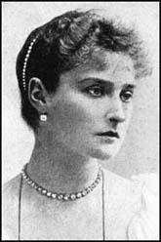
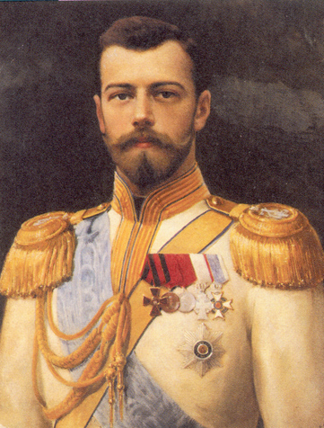
Czar Nicholas II & Alexandra
Alexandra = Czar Nicholas II’s wife
Both the Czar and his wife = very unpopular because they were politically incompetent and foolish
Both relied on the guidance of a mystic healer named Rasputin
This also made them look weak and silly

Slide 6
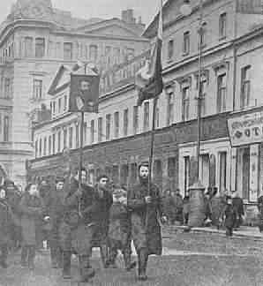
The March Revolution of 1917
People organized strikes and protests demanding food and fuel
Soldiers who were sent to stop the protests ended up joining the protestors
Czar Nicholas II abdicated (gave up) his power on March 15, 1917
End of the 300-year Romanov dynasty in Russia

Slide 7
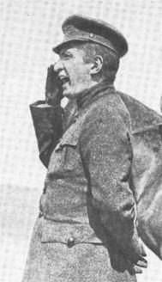
The Provisional Government
Provisional Government = temporary central government in Russia after the Czar stepped down
Led by: Alexander Kerensky
Saw the war effort as the #1 priority
Had to deal with: soldiers deserting, transportation problems, low arms production, etc.

Slide 8
The Provisional Government
Russian masses wanted 3 things:
1) Immediate peace & withdrawal from WWI
2) Transfer of land to the peasants
3) Control of factories by workers
Provisional government did not pull Russia out of the war and did not enact any social reforms
Lost popularity
Led to its downfall

Slide 9
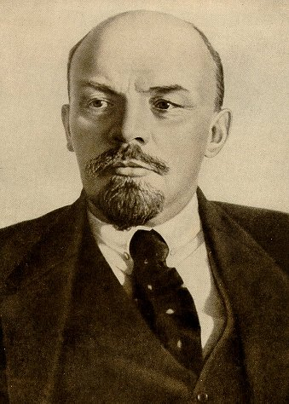
The Bolsheviks
Bolsheviks = radical revolutionary group in Russia
Wanted a socialist society in Russia
Led by: Vladimir Lenin
Slogan = “Peace, land, and bread!”

Slide 10
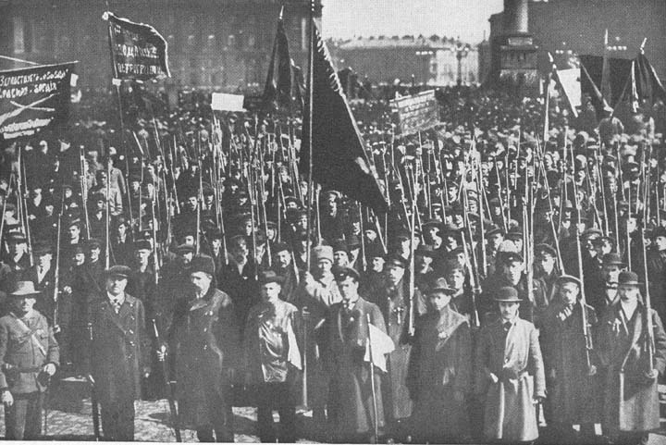
The Russian Revolution
November 1917
Also known as the: Bolshevik Revolution
Bolsheviks staged a coup d’etat in St. Petersburg
Overthrew the provisional government
Members of the provisional government fled or were arrested
Relatively bloodless
Bolsheviks claimed absolute power

Slide 11
The Russian Revolution
Bolsheviks began building a socialist state
Ended private ownership of property
Distributed land among the peasants
Gave workers control of factories and mines
Bolshevik Party = officially renamed the Communist Party in March 1918
Wanted to spread the Communist revolution throughout the world

Slide 12
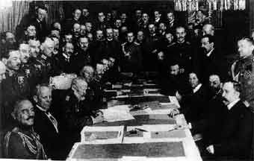
Peace with Germany
Lenin’s 1st order of business = get Russia out of WWI
Signed peace treaty with Germany in March 1918
Russia lost much of its western territory and 1/3 of its population
Peace Conference between Russia and Germany

Slide 13
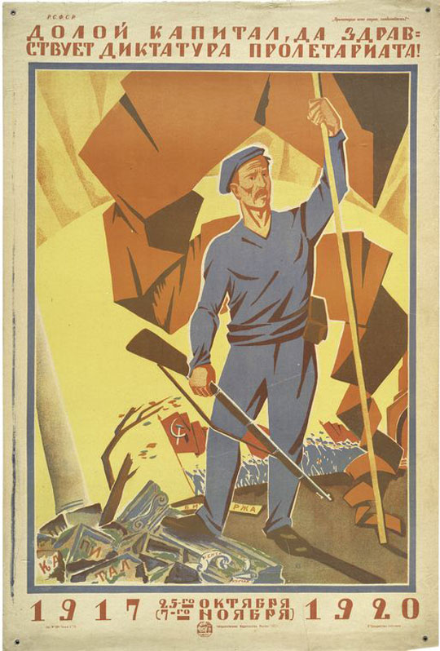
Russian Civil War
1918 – 1921
Communists vs. their political opponents
Political opponents = Royalists, Liberal Democrats, Moderate Socialists, Landlords, etc.
Communists = “the Reds”
Vs.
Their opponents = “the Whites”

Slide 14
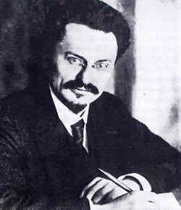
Russian Civil War: The Red Army
Communist Army = called the Red Army
Led by Leon Trotsky

Slide 15
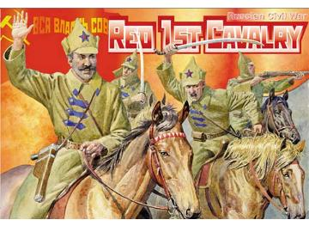
Russian Civil War
Both sides burned villages and killed civilians
In the meantime: workers and peasants were starving and the Russian economy was crumbling

Slide 16
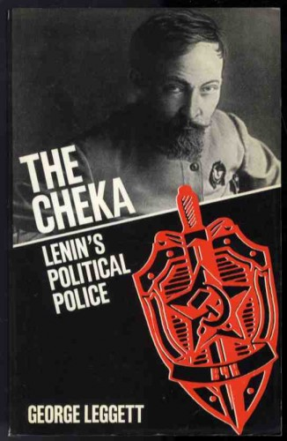
Russian Civil War: The Terror
Bolsheviks imposed a policy called “war communism”
Took direct control over all industries
Forced peasants to send food to the cities
Killed the imprisoned Czar & his family
Set up secret police force = the Cheka
Arrested (and often executed) anyone considered an “enemy of the revolution”
Placed severe restrictions on the Russian Orthodox Church
Communists = anti-religion

Slide 17
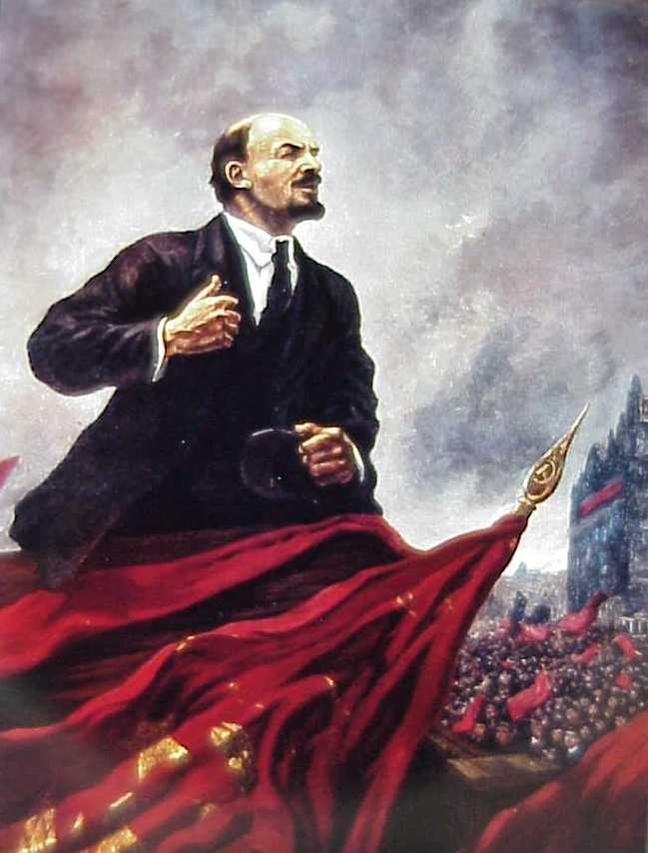
Russian Civil War
“Whites” surrendered in 1921
Outnumbered, disorganized, poorly equipped armies
Lenin and the Communists then had complete control of Russia
Lenin = ruled from 1921-1924
State of Russia = horrible
From 1914-1921 = 27 million Russians had died
Economy = in shambles
Peasants = still starving

Slide 18
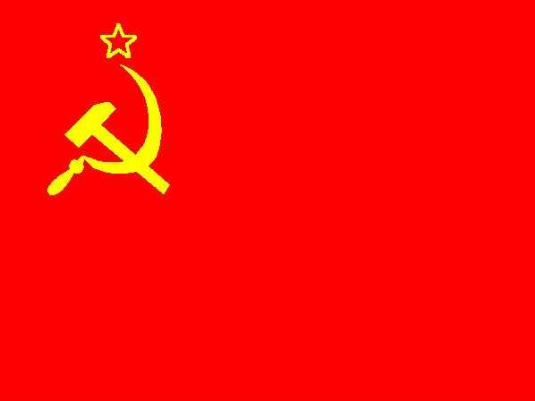
Lenin in Power
1922 = Russia becomes USSR = Union of Soviet Socialist Republics = Soviet Union
New constitution written = makes it a socialist state
In theory = Soviet Union supposed to be run by the workers
But really the Communist Party did

Slide 19
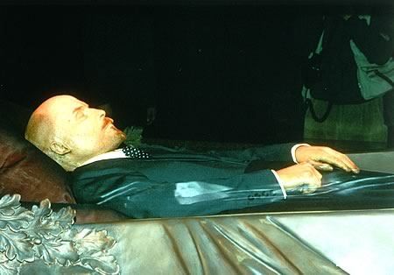
Lenin in Power
Lenin died in 1924 at the age of 54

Slide 20
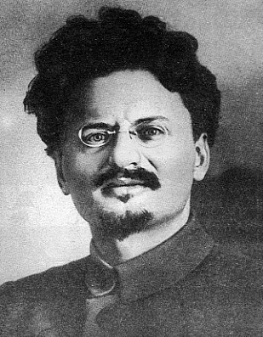
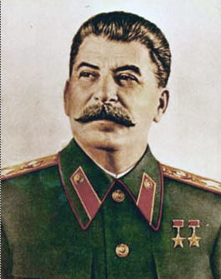
Trotsky vs. Stalin
Fought for power after Lenin died
Leon Trotsky = leader of the Red Army during the Civil War
Joseph Stalin = General Secretary of the Communist Party
Difference = Trotsky wanted to spread Communism all over the world immediately & Stalin wanted to make it strong in the Soviet Union first

Slide 21
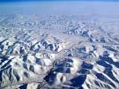
Trotsky vs. Stalin
Trotsky = closer to Lenin and more well-known
Stalin = outmaneuvered Trotsky politically
Ability to remove and appoint government officials
Once he gained control of the government, he exiled Trotsky to Siberia in 1929
Trotsky eventually moved to Mexico City → Stalin sent an assassin there to kill him

Slide 22
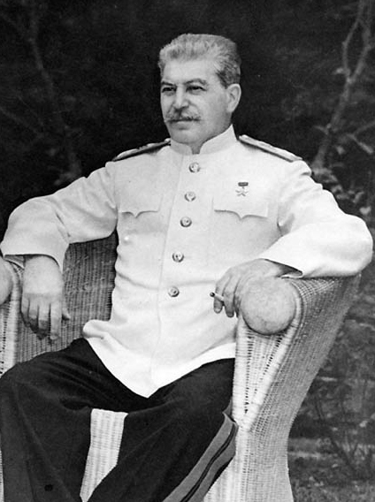
Joseph Stalin
Ruled the Soviet Union from 1929 – 1953
Responsible for the next major extension of communist control
In Eastern Europe after WWII
Soviet military forces already there after the war → stayed there to help impose communist regimes per Stalin’s orders
Stalin wanted to be surrounded by “friendly” governments as security against invasions from the West

