Slide 1
The Arab Empire

Slide 2
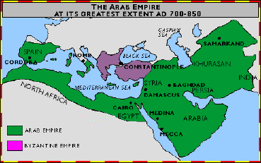
The Arab Empire
Stretched from Spain to India
Extended to areas in Europe, Asia, and Africa
Encompassed all or part of the following civilizations:
Egyptian, Roman/Byzantine, Persian, Mesopotamian, and Indian
With the expansion of the Arab Empire came the spread of:
Islamic faith
Arabic language
Culture of Arabia

Slide 3
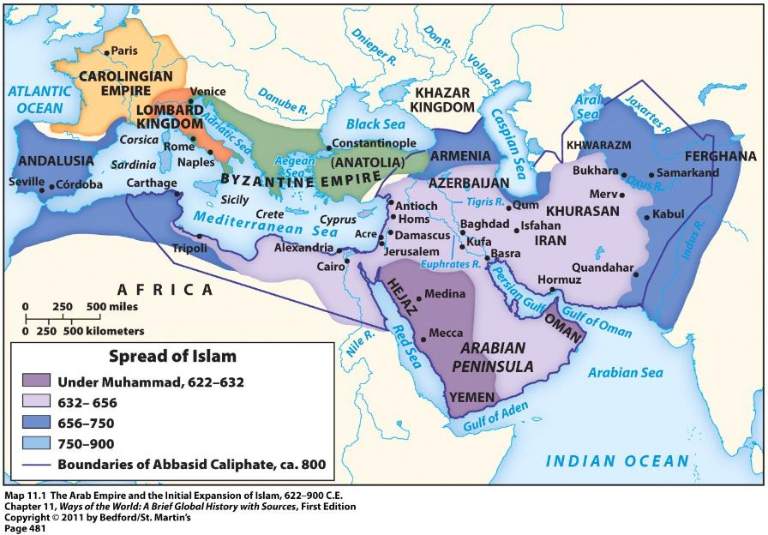

Slide 4
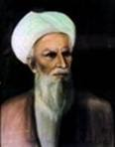
Divisions and Controversies
The “Rightly Guided Caliphs” (632 – 661)
First 4 caliphs after Muhammad
(Caliph = the political and religious leader of the Islamic community)
Close companions of Muhammad
Chosen by Muslim elders of Medina
Division surfaced almost immediately
Sunni vs. Shia Split
Abu Bakr
The 1st Rightly
Guided Caliph

Slide 5
Sunnis vs. Shi’ites
Believe the caliph is the rightful political and military leader of Islam
Believe the caliph should be chosen by the Islamic community
Believe the caliph can be any devout Muslim
Religious authority comes from the larger Islamic community; particularly ulama = religious scholars
Believe that the leader of the Islamic community should be a blood descendant/relative of Muhammad
Religious authority comes from prayer leaders called imams
Imams = only ones that can correctly interpret divine revelations and Islamic law

Slide 6
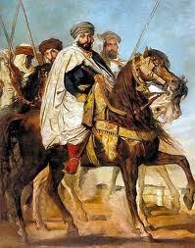
Islamic Caliphs
As the Arab Empire grew, caliphs were transformed from modest Arab chiefs into absolute, all-powerful monarchs
Elaborate court rituals
Complex bureaucracy
Standing army
Centralized systems of taxation and money
2 major ruling dynasties came to control the Arab Empire during this time = Umayyad dynasty and Abbasid dynasty

Slide 7
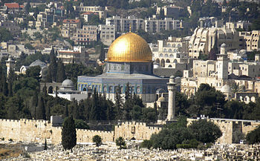
Umayyad Dynasty (661 – 750)
Vast expansion of Arab Empire
Caliphs became hereditary rulers
Empire’s capital moved from Medina to Roman/Byzantine city of Damascus in Syria
Ruling class = Arab military aristocracy
The Dome of the Rock
Built in Jerusalem in 691 CE
Built by Umayyad Caliph Abd al-Malik

Slide 8
Umayyad Dynasty (661 – 750)
Overthrown because:
Non-Arabs resented their status as second-class citizens
Shia Muslims believed Umayyad caliphs were illegitimate
Many Arabs protested the luxurious living of their rulers

Slide 9
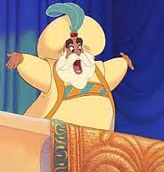
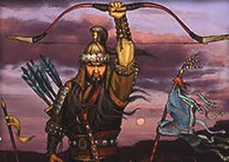
Abbasid Dynasty (750 – 1258)
And no, we can’t watch Aladdin OR Mulan in class.
Built up a new capital for the empire in Baghdad
Non-Arabs now played a prominent role
Persian culture became the culture of Islamic elites
Political unity = didn’t last long
By the mid-800s = many local governors or military commanders asserted autonomy over their regions
Islamic world fractured into multiple “sultanates”
Dynasty officially ended when conquered by the Mongols in 1258

Slide 10
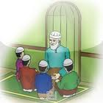
The Hadiths
The Hadiths = traditions about the sayings or actions of Muhammad
Became an important source of Islamic law

