Slide 1
World War I
(1914-1918)

Slide 2
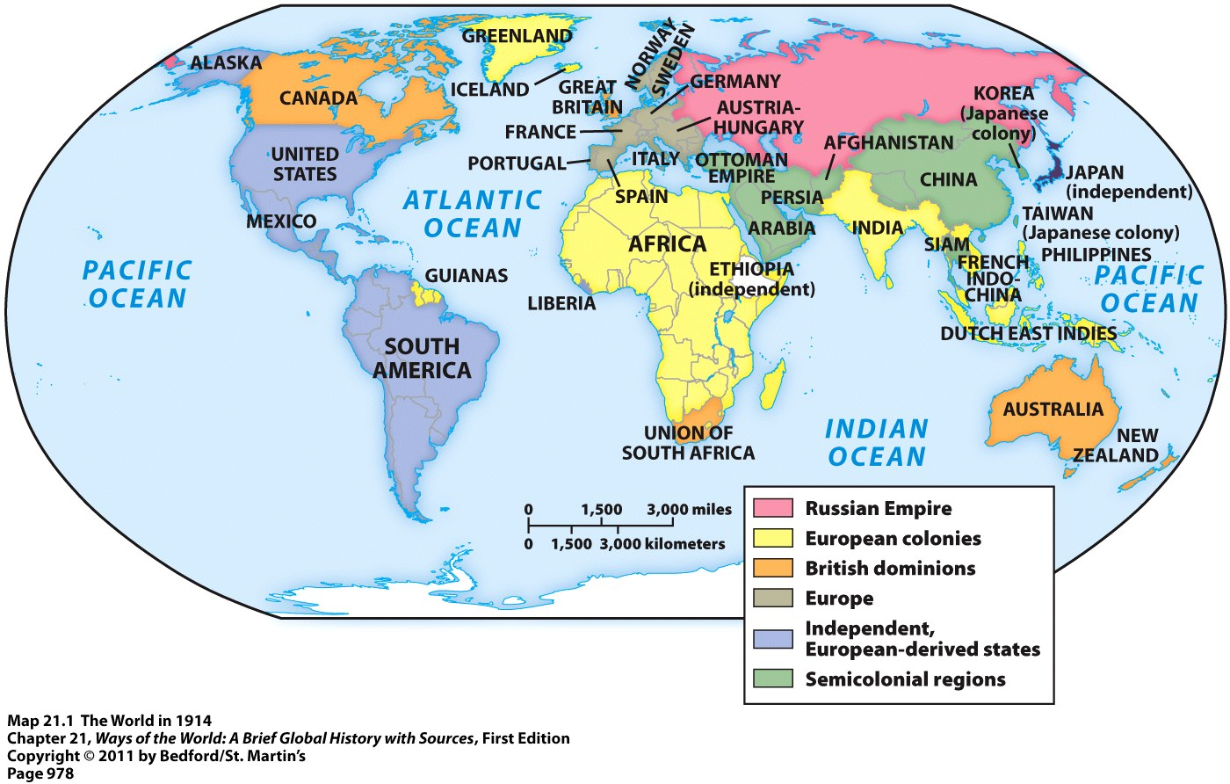
The World in the Early 20th Century
By 1900 = Europeans, or people with a European ancestry, largely controlled the entire world through their formal empires or informal influence
This would all change over the next few decades

Slide 3
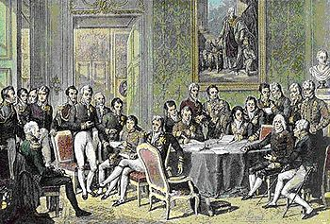
The World in the Early 20th Century
Rivalry and competition between European states continued throughout the 19th and early 20th centuries
Fragile peace was barely being maintained after the defeat of Napoleon and his empire in 1815
  Congress of Vienna (1815) = international meeting held to redraw European boundaries
  Attempt to create a peaceful balance of power in Europe
Rivalries and competition intensified with the unification of Italy and Germany in 1871
The Congress of Vienna (1819)

Slide 4
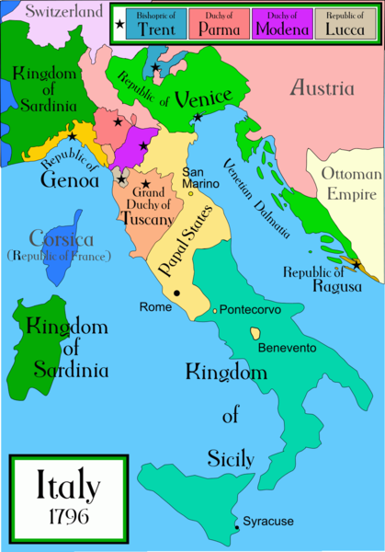
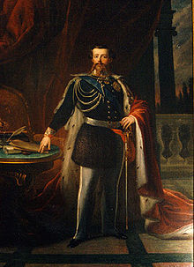
Italian Unification
Italy had been divided up into several independent city-states
Process of Italian unification began following the defeat of Napoleon in 1815
Unified in 1871
1st King of a united Italy = Victor Emmanuel II

Slide 5
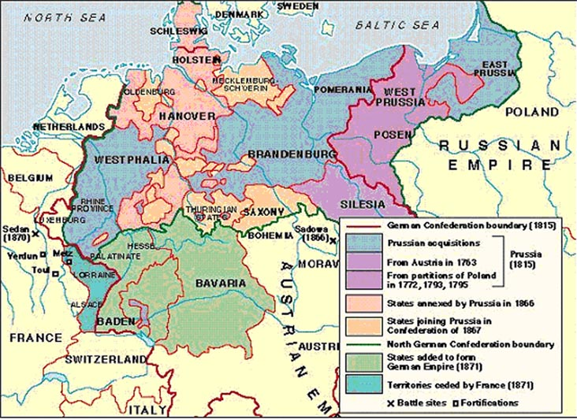
German Unification
Last major European power to unify
Was divided up into 39 independent states
  Largest = Prussia

Slide 6
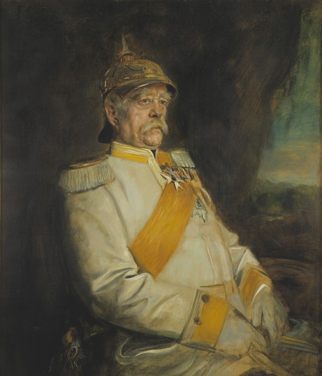
German Unification
Otto von Bismarck = prime minister of Prussia
Wanted strong government & army → unification would come through “blood and iron”
Embraced realpolitik = right of a country to pursue its own advantages by any means, including war

Slide 7
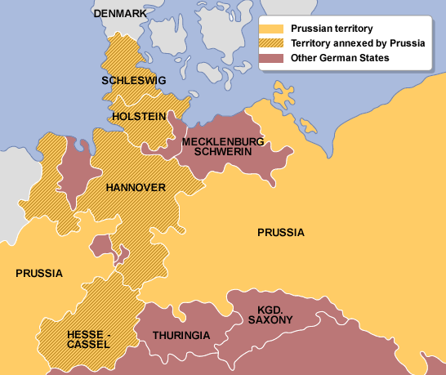
German Unification
1864 = War against Denmark
Denmark ruled Schleswig and Holstein = large German populations there
Bismarck formed a temporary alliance with Austria
  They won
  Prussia got Schleswig
  Austria got Holstein

Slide 8
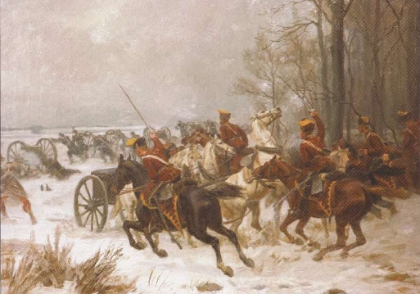
German Unification
1866 = Austro-Prussian War
Bismarck formed alliances with Russia, France, and Italy
  Prevented them from forming alliances with Austria
Bismarck’s goal = to create a Germany under Prussian domination that excluded Austria
  He won
Austria gave Holstein to Prussia
Austria gave Venetia to Italy
Prussian Calvary in the
Austro-Prussian War

Slide 9
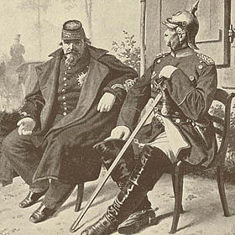
German Unification
1870-1871 = Franco-Prussian War
France = a threat to a united Germany
France demanded some territory from Prussia as compensation for their alliance in the last war
Bismarck refused → eventually led to war between the two nations
  Bismarck won
Prussia gained the French territory of Alsace-Lorraine = major industrial site
Napoleon III of France seated next to Prussian Chancellor Otto von Bismarck, holding Napoleon’s surrendered sword

Slide 10
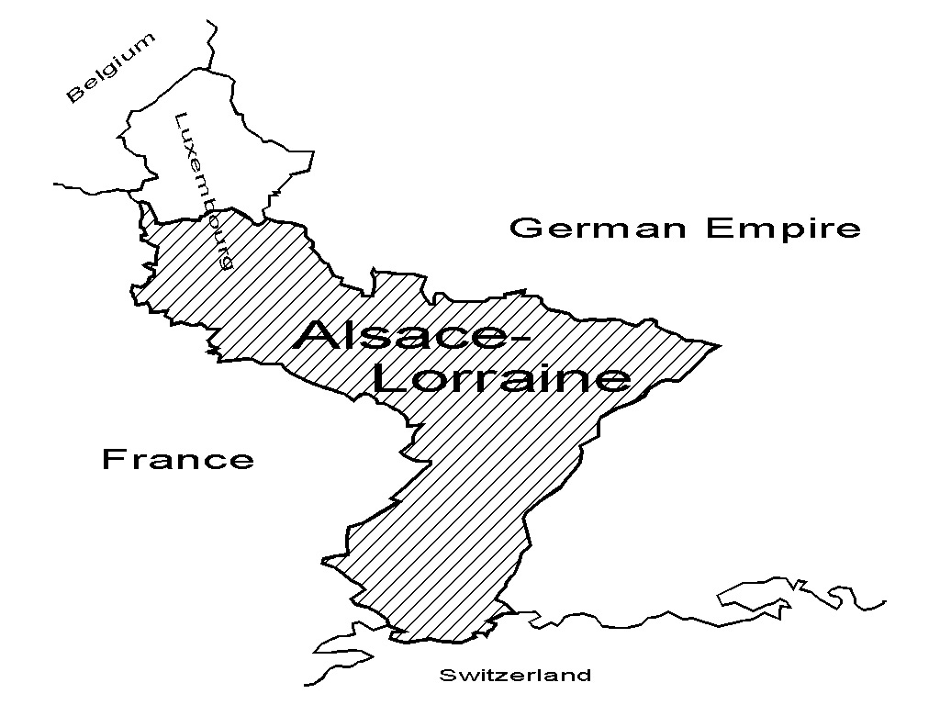
German Unification

Slide 11
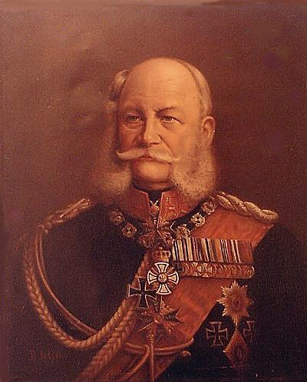
German Unification
Unified in 1871
1st Kaiser (emperor) = Wilhelm I
Bismarck = chancellor = chief minister

Slide 12
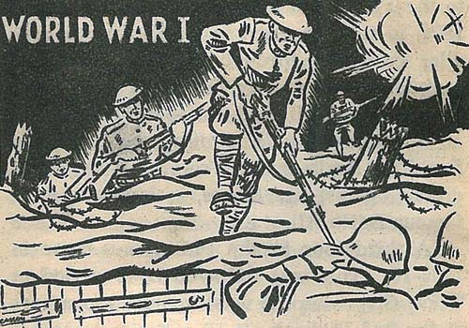
MAIN Causes of WWI
Militarism
Alliances
Imperialism
Nationalism

Slide 13
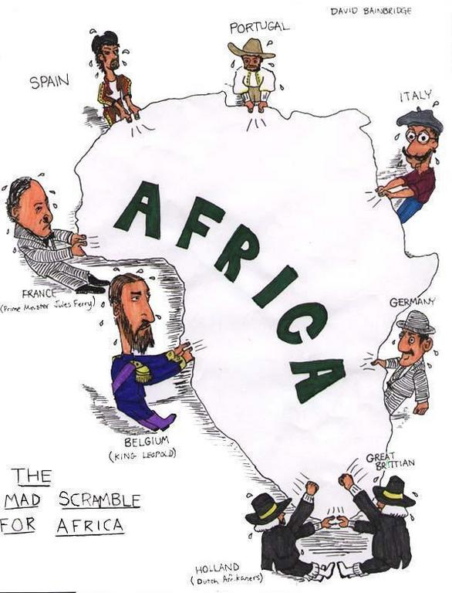
Imperialism
European = imperialist rivalries since the 1800s
Competed for territory and economic power all over the world
  Especially in: Africa, Southeast Asia, the Middle East, China, and the Balkans
Competition turned to hostility and conflict as European’s “got in each other’s way”

Slide 14
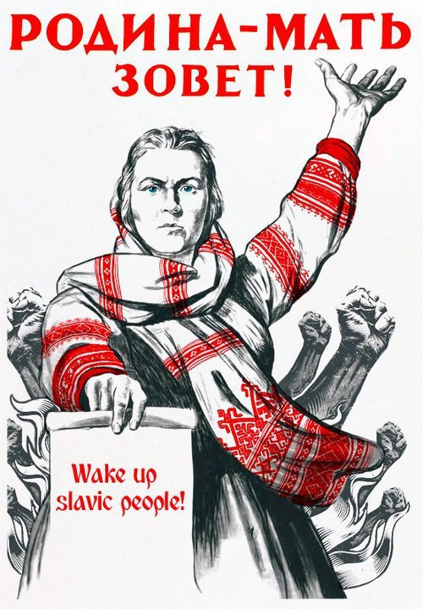
Nationalism
Nationalism had unified Germany and Italy and was becoming more and more popular
The French wanted Alsace-Lorraine back from Germany
In Austrian Empire = nationalism was creating the most violent tensions in Europe
  Pan-Slavism = Slavic nationalism
  Desire to unite all of the Slavic people under one empire

Slide 15
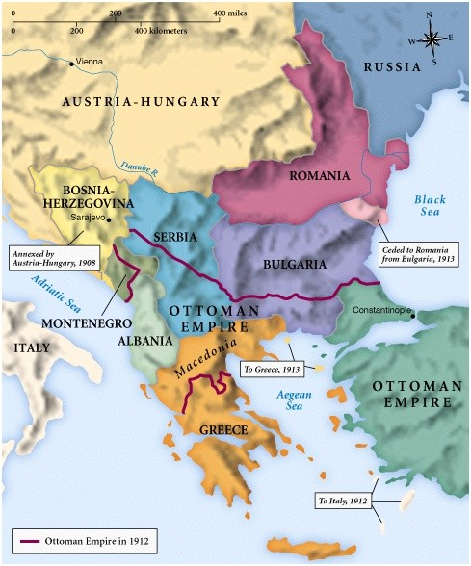
Pan-Slavism
Many Slavic people = in the Austrian and Russian Empires
Many Slavic people = in the Balkans = region once controlled by the Ottoman Empire (which was now falling apart)
Major country in favor of Pan-Slavism = Serbia

Slide 16
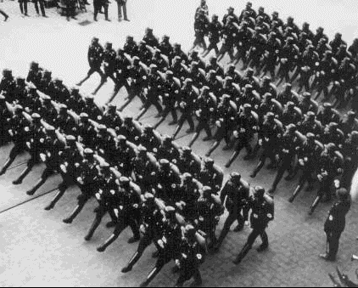
Militarism
Militarism = glorification and expansion of the military
Countries began to build up their militaries and spend money on military training
Many countries began conscription = draft of civilians into the military
Domino effect → when one country enhanced its military, other countries would do the same

Slide 17
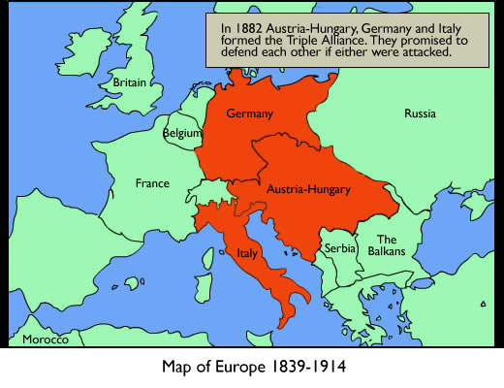
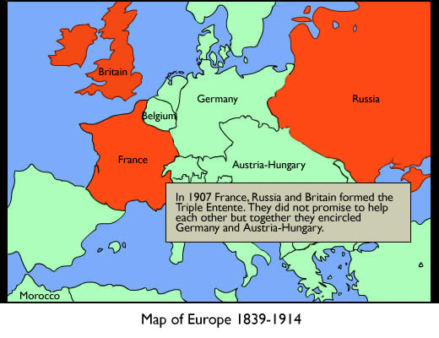
Alliances
Alliance systems = defense agreements among nations
2 major alliance systems:
  Triple Alliance = Germany, Austria-Hungary, and Italy
  Triple Entente = Great Britain, Russia, and France

Slide 18
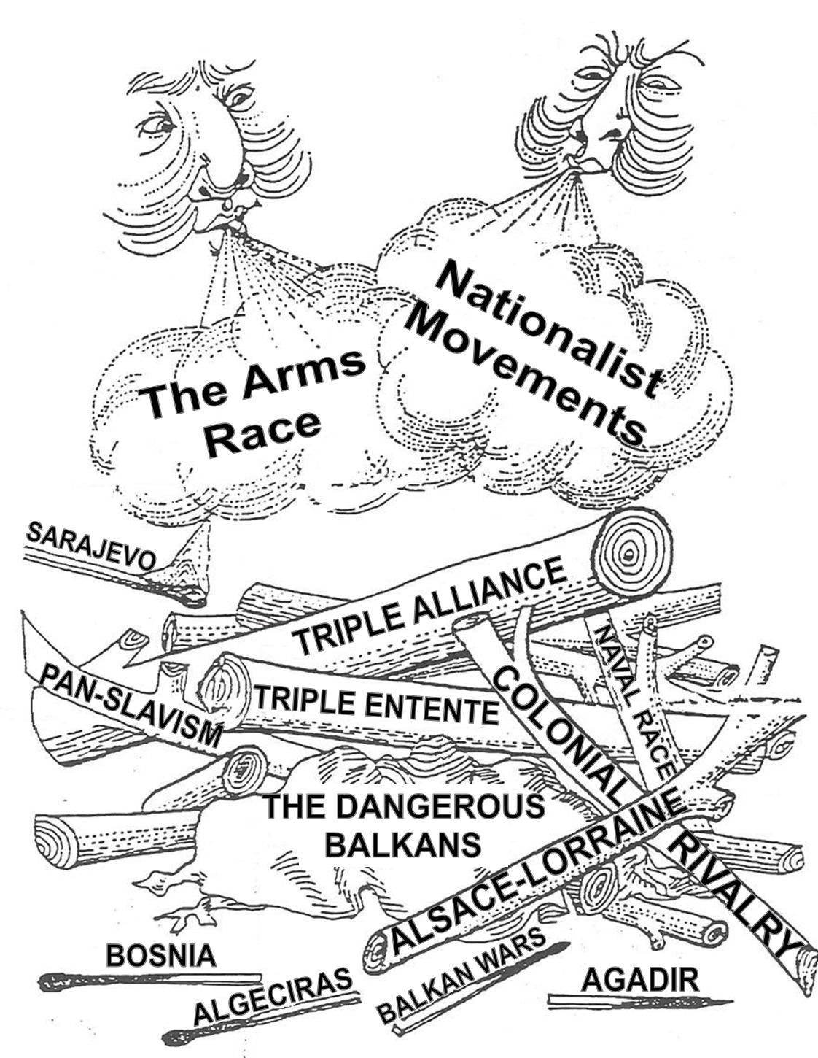

Slide 19
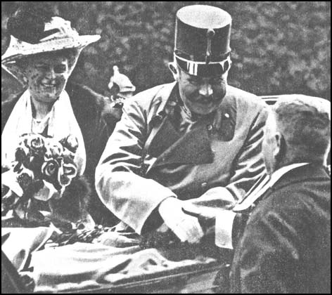
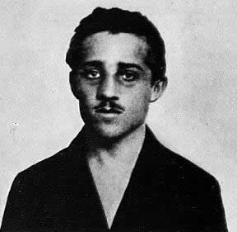
The “Spark” of WWI
June 28, 1914 = Archduke Francis Ferdinand (heir to the throne in Austria-Hungary) was assassinated
His wife Sophie was also killed
Both were in Sarajevo = capital of Bosnia-Herzegovina
  A territory controlled by Austria-Hungary with a very big Slavic population
Murdered by Gavrilo Princip = member of the Black Hand = secret Slavic nationalist group

Slide 20
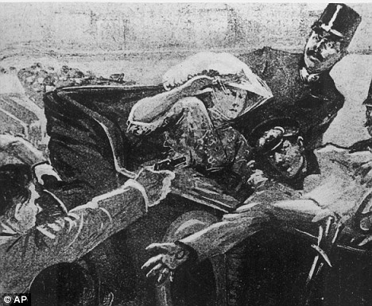
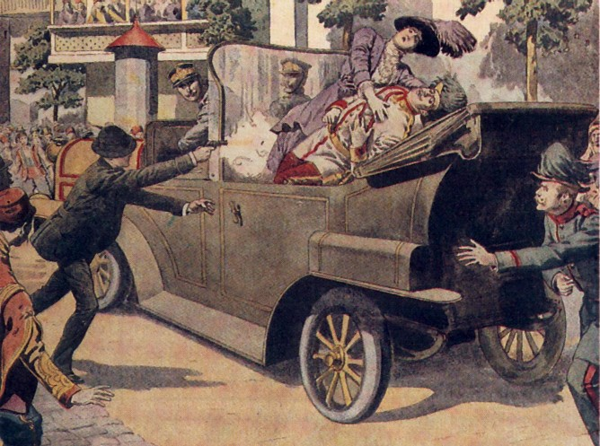
The Assassination

Slide 21
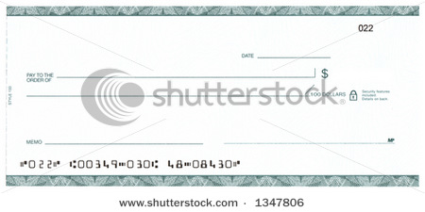
German Support
Austria-Hungary approached Germany and made sure that Germany would support it if it took action against Serbia
Germany promised a “blank check” of support
  Unconditional and full support

Slide 22
Declaration of War
Austria-Hungary gave Serbia an ultimatum
1) Serbia must let A-H officials into the country to stop all violent, nationalist movements
2) Serbia must let A-H officials into the country to investigate the assassination
Serbia said: NO
July 28, 1914 = A-H declared war on Serbia
Both countries started mobilization = preparing the military for war

Slide 23
A European War
Russia began to mobilize
  Supported Serbia and Pan-Slavism
France began to mobilize to support Russia
Germany gave Russia and France an ultimatum = stop mobilizing or face war
  They didn’t stop
  Germany declared war on Russia and France
Great Britain tried to stay neutral

Slide 24
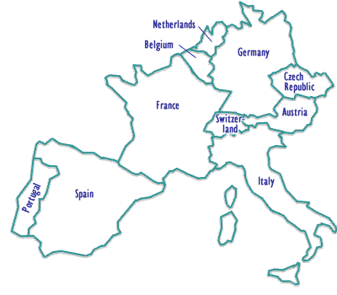
A European War
August 1914 = Germany invaded neutral Belgium in order to get to France
This led Great Britain to declare war on Germany
  Did not like that Germany was getting so close to them
  Did not like that Germany was invading neutral countries

Slide 25
Other Nations Join the War
For the Central Powers (formerly the Triple Alliance):
  1914 = Ottoman Empire
  1915 = Bulgaria
For the Allied Powers (formerly the Triple Entente):
  1914 = Serbia, Belgium, Montenegro, Romania, Greece, Portugal
  1914 = Japan → wanted German territories in the Pacific
  1915 = Italy switched alliances → Allies promised Italy territories in A-H when they won
  1917 = U.S.

Slide 26
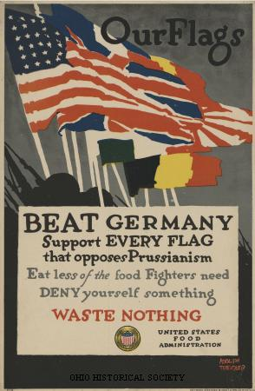
Response of the People
People in every country responded with patriotic enthusiasm
  Cheered for their country
  Supported their troops
Nobody knew how devastating the war would actually be to Europe
  (No country stockpiled more than 6 months worth of ammunition and supplies)

Slide 27
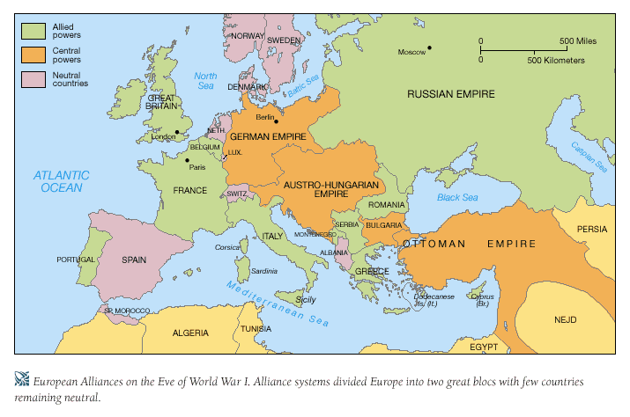
Europe in 1917

Slide 28
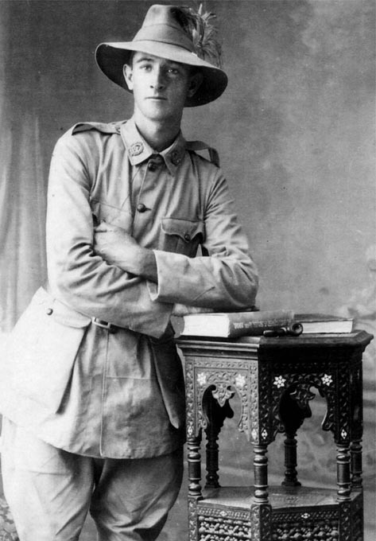
Military Aspects of WWI
Worldwide involvement = first time in world history that all major nations were involved in a war
  Every continent provided troops for combat
  Colonial troops and laborers funneled in from Africa, India, China, Southeast Asia, Australia, New Zealand, Canada, and South Africa
A Young Australian Recruit

Slide 29
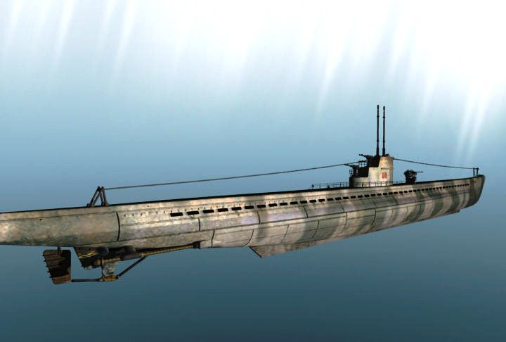
Military Aspects of WWI
Naval warfare = battles between the British and German navies were very common
  They would also set up blockades to stop each other from receiving food & materials
  Germans used U-Boats = submarines

Slide 30
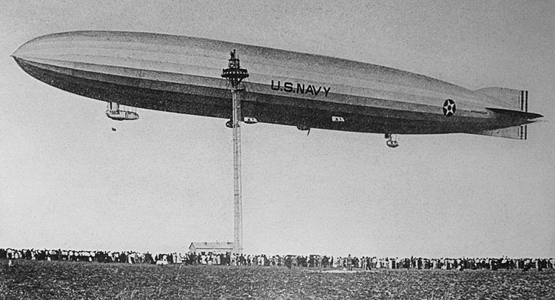
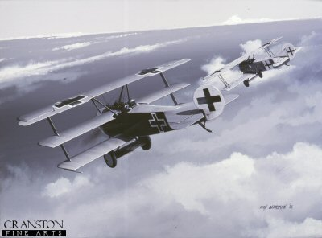
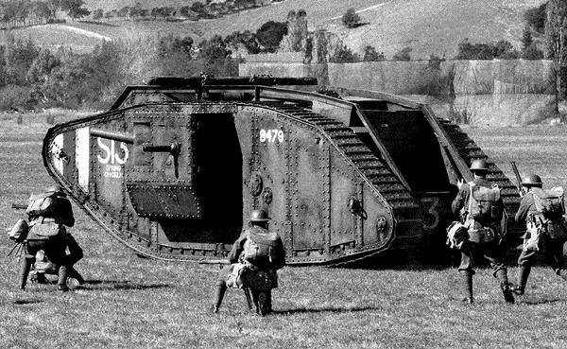
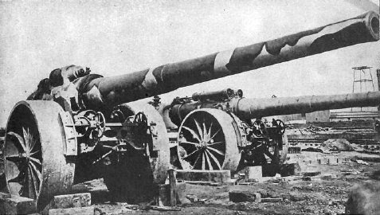
Military Aspects of WWI
New Weapons
  Dirigibles (airships)
  Submarines
  Machine guns
  Giant artillery guns
  Tanks
  Airplanes
  Poison gas
  Gas masks

Slide 31
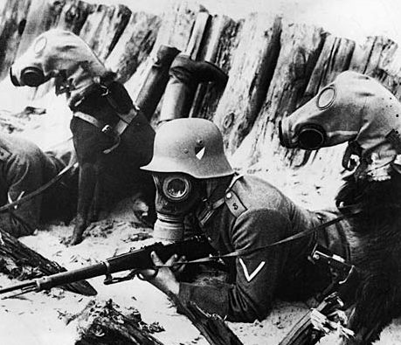
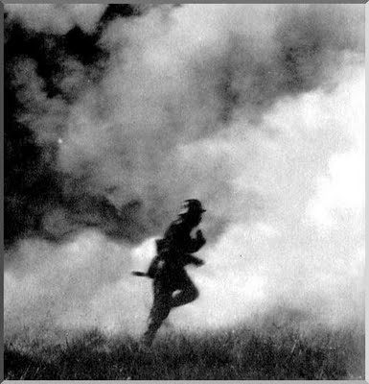
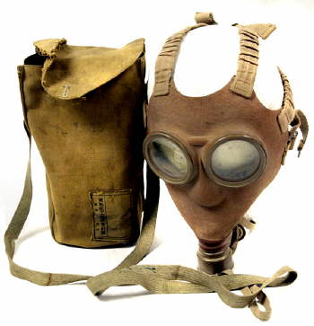

Slide 32
Military Aspects of WWI
Trench Warfare
  Used on the Western Front
  Complex system of trenches and tunnels
  Soldiers would be in them for several weeks at a time
  Soldiers suffered from boredom, disease, rats, mud, cold, standing water, etc.
  “Trench foot” = when the feet would begin to rot and decay due to exposure to water and cold
    Often got infected → could lead to gangrene

Slide 33
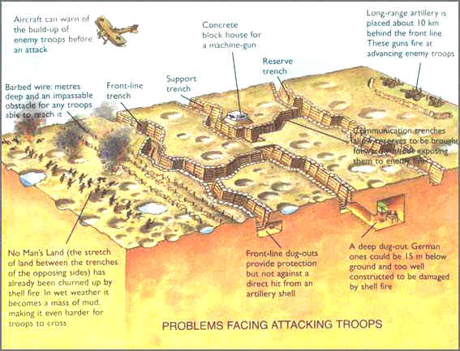

Slide 34
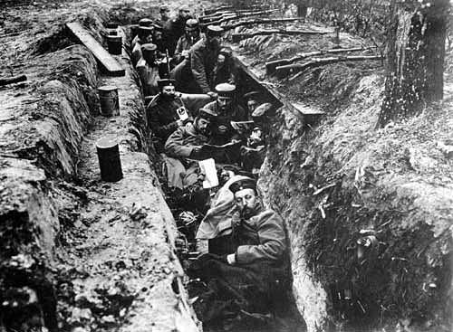
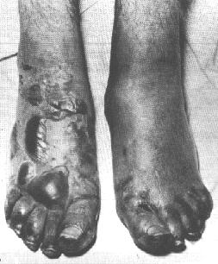
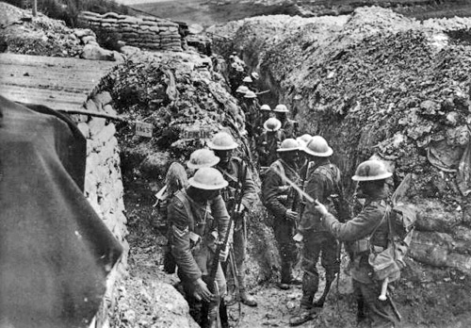
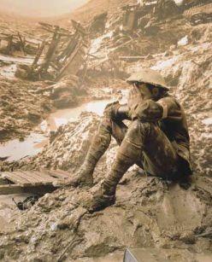

Slide 35
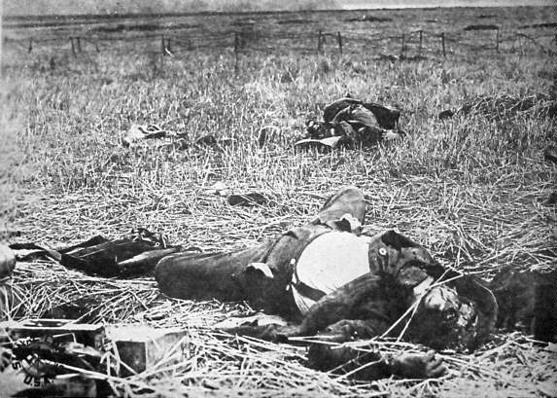
Military Aspects of WWI
Trench Warfare (cont.)
  Trenches were surrounded by barbed wire -- men often got caught in it
  Space in between the trenches = “No man’s land”
  “No man’s land” = scattered with land mines
  WWI became a war of attrition = trying to wear down the other side with constant attacks

Slide 36
WWI = “Total War”
Total War = countries involved used every resource available for the war effort
On the home front = people mobilized resources for the military front
  Hole in the workforce because the war took any men old enough to fight
  Women went to work in the factories
  Poor people benefited from new work
  Factories made war products instead of domestic products
  “War socialism” = governments took more control over the economy during the war; needed war supplies

Slide 37
Major Theaters of War
“Theater” of war = the location
In WWI = 2 theaters
  Western Front
  Eastern Front

Slide 38
Western Front
Plan XVII = French plan to go on offensive attacks without concern for the opponent’s strategy
  Led to mass casualties in the war
Schlieffen Plan = Germany’s military plan to avoid war on 2 fronts

Slide 39
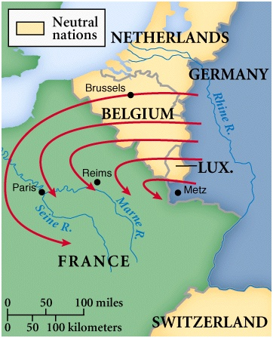
The Schlieffen Plan
Created by German General Alfred von Schlieffen
Plan = go into France through Belgium and conquer France, THEN turn back around through Germany to get Russia
  Believed Russia would be slow to mobilize because so large
  Paris = objective of German push in France after getting through Belgium

Slide 40
Stalemate on the Western Front
Both sides continued to fight with neither side making any real progress
Both sides were losing troops, ammunition, supplies, food, medicine, etc.
Both sides had to change their war strategy:
  Recruitment of Civilians
  Propaganda = used by the government to make the enemy look beastly and inhuman

Slide 41
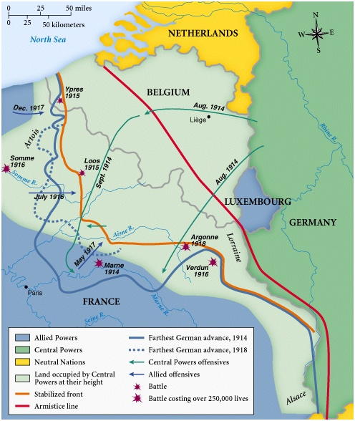
Major Battles on the
Western Front
Battle of the Marne
Battle at Verdun
Battle of the Somme
Second Battle of the Marne

Slide 42
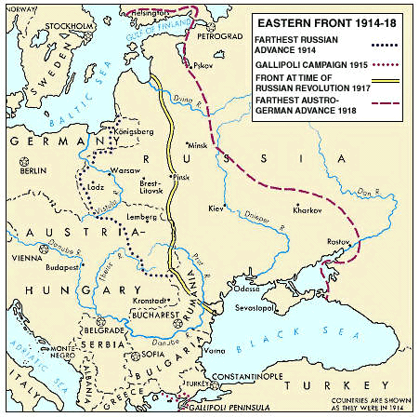
The Eastern Front
Didn’t use trench warfare
War here = mobile and involved constant changes in battlefield positions
Neither side ever achieved a complete victory here either

Slide 43
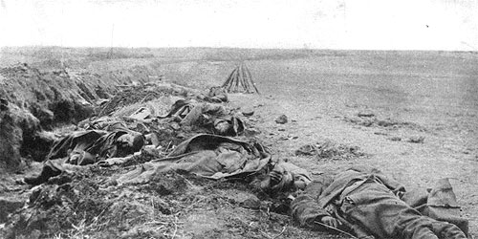
The Russian Disaster
August 1914
Russians invaded eastern Germany
Diverted German troops from the Western Front
But Russia ended up suffering a disastrous defeat
  30,000 Russians killed
  92,000 Russians taken prisoner

Slide 44
Continuous Russian Defeats
1914 - 1917 = Russia continued to suffer harsh defeats by German armies
  Lost millions of men, supplies, ammunition, guns, etc.
  Morale in Russia = VERY LOW
Although the Russians suffered, their efforts helped the Allies over on the Western Front

Slide 45
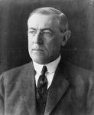
The U.S. Enters the War
President Woodrow Wilson had issued the Proclamation of Neutrality
  Said that U.S. would stay neutral in WWI
But world events led the U.S. to get involved in the war
  In 1917 = the U.S. declared war on Germany

Slide 46
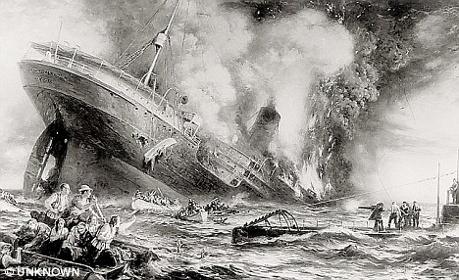
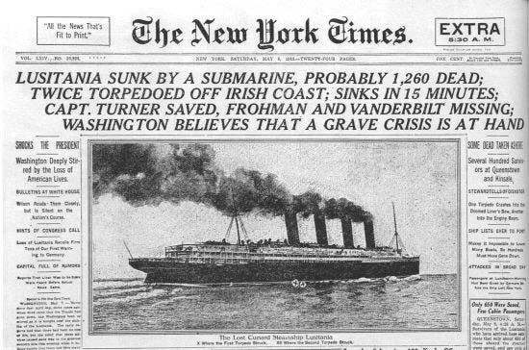
The Lusitania

Slide 47
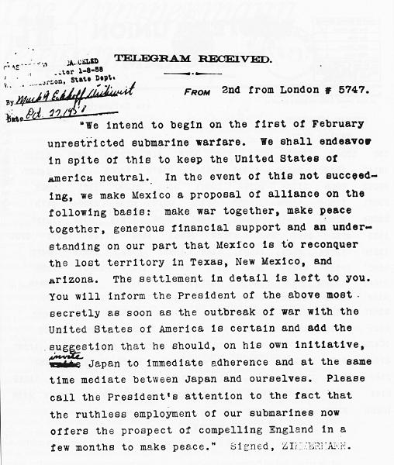
The U.S. Enters the War
The Zimmerman Telegram
  Intercepted by the British & given to U.S.
  Sent from Germany to Mexico
  Said that if Mexico supported Germany in WWI, then Germany would help Mexico get land it lost to U.S. in Mexican-American War

Slide 48

Significance of the U.S. in WWI
Turned the tide of WWI in favor of the Allies
Broke sharply with America’s traditional avoidance of foreign conflicts
Marked America’s emergence as a world power → eventually led to world leadership

Slide 49

Germany Surrenders
September 1918 = German generals von Hindenburg & Ludendorff told Kaiser Wilhelm II that the war could not be won
Collapse of Central Powers followed

Slide 50

Wilson’s 14 Points:
Trying to Restore the Peace
Freedom of the seas
Removal of international trade barriers
Reduction in arms
End to secret alliances
Adjustment of European boundaries according to nationality
League of Nations = “general association of nations”
14 Points = guiding framework for peace settlement

Slide 51

Paris Peace Conference
January 1919
Representatives from 27 nations met
No one from Central Powers or Russia invited
5 separate peace treaties signed
  Biggest one = Treaty of Versailles
Most decisions made by the “Big Four”

Slide 52




The “Big Four”
Prime Minister Vittorio Orlando (Italy)
President Woodrow Wilson (U.S.)
Prime Minister Georges Clemceau (France)
Prime Minister David Lloyd George (Britain)

Slide 53
Treaty of Versailles
Signed June 28, 1919
Territorial Provisions
- Germany gave Alsace-Lorraine to France
- Germany gave Saar coal mines to France
- Germany gave small areas on its border to Denmark and Belgium
- Other border changes were made based on nationality

Slide 54
Treaty of Versailles
2) Colonial Provisions
- Germany had to give up all of its overseas colonies to the Allies
- Great Britain & France split Germany’s colonies in Africa
- Australia took German Pacific islands south of the Equator
- Japan took German Pacific islands north of the Equator

Slide 55
Treaty of Versailles
3) Disarmament
- German army limited to 100,000 volunteers
- Submarines & aircrafts banned in Germany
- Draft banned in Germany
- German navy reduced to a few small ships
- Demilitarization of the Rhineland in Germany

Slide 56
Treaty of Versailles
4) War Guilt Clause and Reparations
- Germany had to accept SOLE responsibility for the war
- Germany had to pay reparations = payments for all war damages

Slide 57

Treaty of Versailles
5) Creation of the League of Nations
- Ended up being very weak
- U.S. Senate refused to join
- Not enforced well
- Not strong enough to stop WWII
- Collapsed in 1940

Slide 58


League of Nations Mandates in the Middle East
Mandate = a territory administered by another country

