Slide 1
Classical China Zhou, Qin, Han Dynasties
AP World History
600 BCE to 600 CE

Slide 2
Timeline of Classical China
Shang: 1766 - 1122 BCE
Zhou: 1029 - 258 BCE
Era of Warring States: 402 BCE - 201 BCE
Qin: 221 - 202 BCE
Han: 202 BCE - 220 CE

Slide 3
Chinese Dynastic Cycle
New family establishes dynasty (new institutions, economy)
Dynasty grows weak
Social Divisions Increase
Internal rebellions and/or external rebellions
New dynasty emerges

Slide 4
Mandate of Heaven
Belief that the gods transfer their power to a specific family in China that is meant to establish a dynasty and rule the region
Emperors were Sons of Heaven

Slide 5
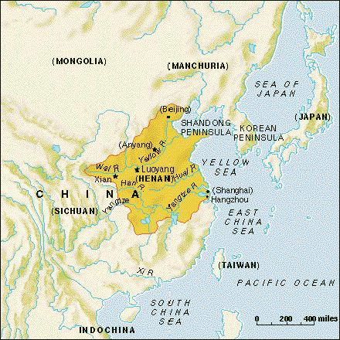

Slide 6
Zhou
Social
Rise of a strong, landowning class; inherit social status
Patriarchal
Political
Loose alliance of regional princes, depended on loyalty; relatively weak rulers
Exchange land for promise of taxes and military - Feudalism
Landowners become more powerful than rulers
Interactions
Expanded the Middle Kingdom
Cultural
Banned human sacrifice; formalized religious practices; Ancestor worship; focus on harmony
Promoted use of one language for everyone
End of dynasty leads to development of new philosophies (Confucianism)
Tea ceremonies; chopsticks
Economic
Agriculture dominated (N-wheat; S-rice)

Slide 7
Period of Warring States
402 BCE - 201 BCE
Competing interests of landowning class and ruling class cause political turmoil
Landowners raise own military - origins of regional warlords
No political unity - China is exceptionally weak
Cultural innovations survive
Results in new philosophies

Slide 8
Rise of Chinese Philosophies
Confucianism
Daoism/Taoism
Legalism

Slide 9
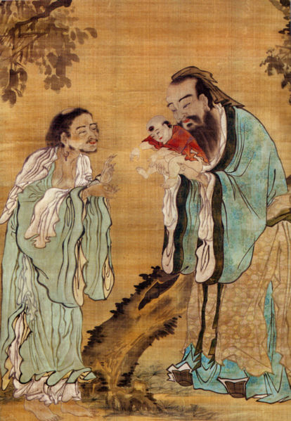
Confucianism
Confucius (K’ung Fu Tzu)
Period of Warring States
Scholar - history, music, ethics
Main Writing: The Analects
Promoted by followers - Mencius

Slide 10
Main Ideas
Restore social order, harmony and good government to China
Ethical systems based on relationships and personal virtue
Emphasized family
Filial piety - respect for parents and elders is necessary for order
Early Zhou Dynasty was seen as perfect society
Inferiors devoted to service
Superiors looked after dependents

Slide 11
Confucianism
Five Basic Relationships in Society
Ruler/Subject
Father/Son
Husband/Wife
Older Brother/Younger Brother
Friend/Friend
Chinese gentleman - education and moral standards; birth status not important
Bureaucracy - those who help run government
Courteous, precise, generous, just/fair

Slide 12
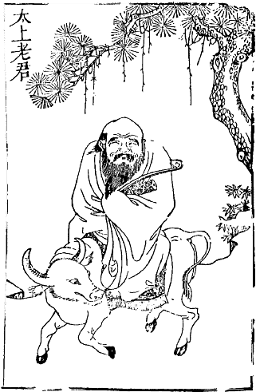
Daoism/Taoism
Founded by Lao Tze (604-531 BCE)
Main Writing: Tao-te-Ching (The Way of Virtue)
Human actions are not important
Most important part of society is natural order of things
The Tao (The Way) - guides all things

Slide 13
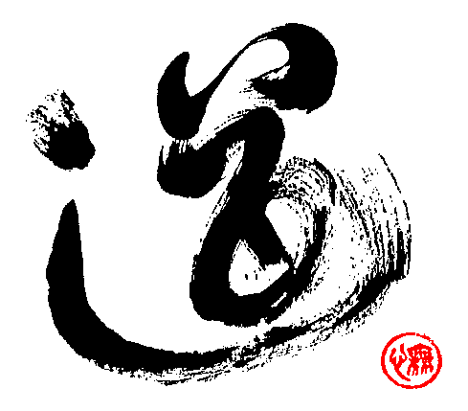
Daoism/Taoism
Search for knowledge and understanding of nature
To understand nothing, it is best to do nothing, to observe nature
Nature is not jealous or power hungry
Does not argue about right or wrong, good or bad

Slide 14
Legalism
Practical, political reaction to Confucianism
Han Feizi - 3rd century BCE
Powerful and efficient government is key to restoring order
Laws will end civil war and restore harmony
Rewards to good subjects and punish disobedient
Rulers must control ideas and actions of people
Favored by Shi Huangdi during Qin dyansty

Slide 15
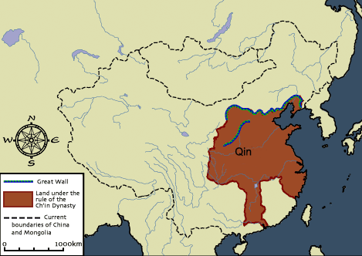

Slide 16
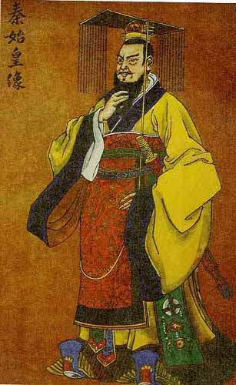
Qin Dynasty
Emerges out of end of Zhou Dynasty/Period of Warring States
Founder: Shi Huangdi (“First Emperor”)
Goals:
Unify and expand China
Restore order

Slide 17
Social
Primogeniture eliminated (practice of having eldest son inherit all property and land)
Nobles must leave land and live in Emperor’s court
Political
Emperor had complete control over all aspects of society
Use of brutality and force to accomplish goals
Bureaucracy (not of the nobility) expanded to help control all regions
National census
Single law code
Interactions
Army expanded to crush rivals and regional rebellions
Expanded territory of China, including Hong Kong
Influenced parts of Vietnam through conquest
Expanded infrastructure to increase interactions

Slide 18
Cultural
Confucianism looked down upon and followers persecuted
Legalism promoted
Architectural: Initiates construction of Great Wall; Terracotta Soldiers/Tomb of Shi Huangdi
Uniform written language
Banned books
Economic
Introduced standard weights and measures
Eliminated the very rare practice of slavery
Forced labor necessary for construction projects
Extremely high taxes
Sponsored agricultural projects (irrigation) and manufacturing of silk

Slide 19
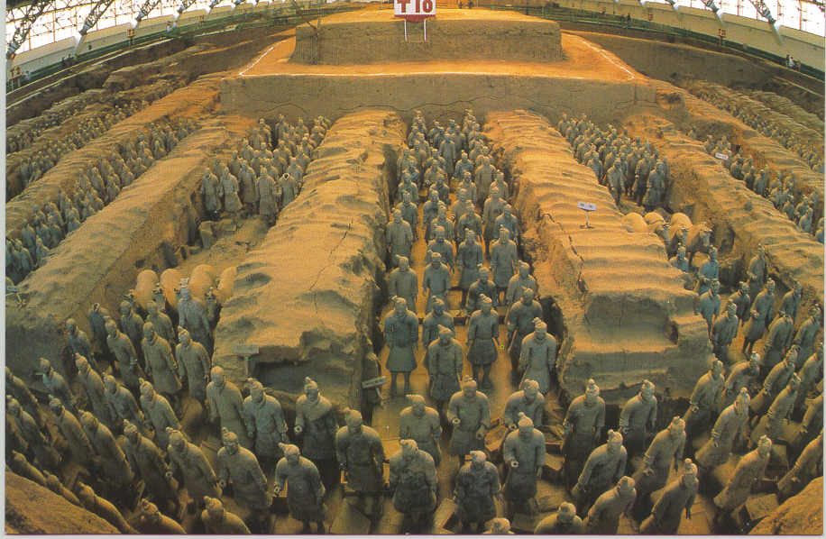

Slide 20
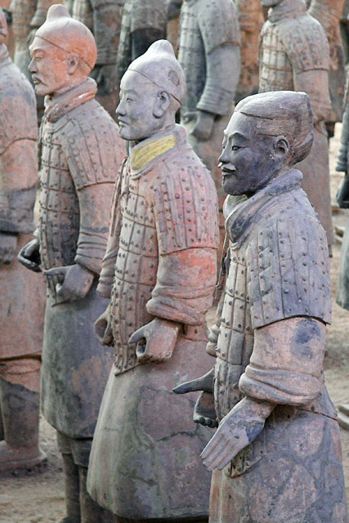
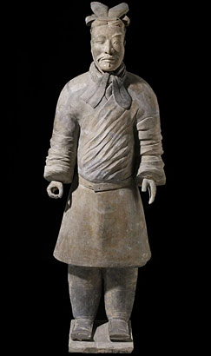
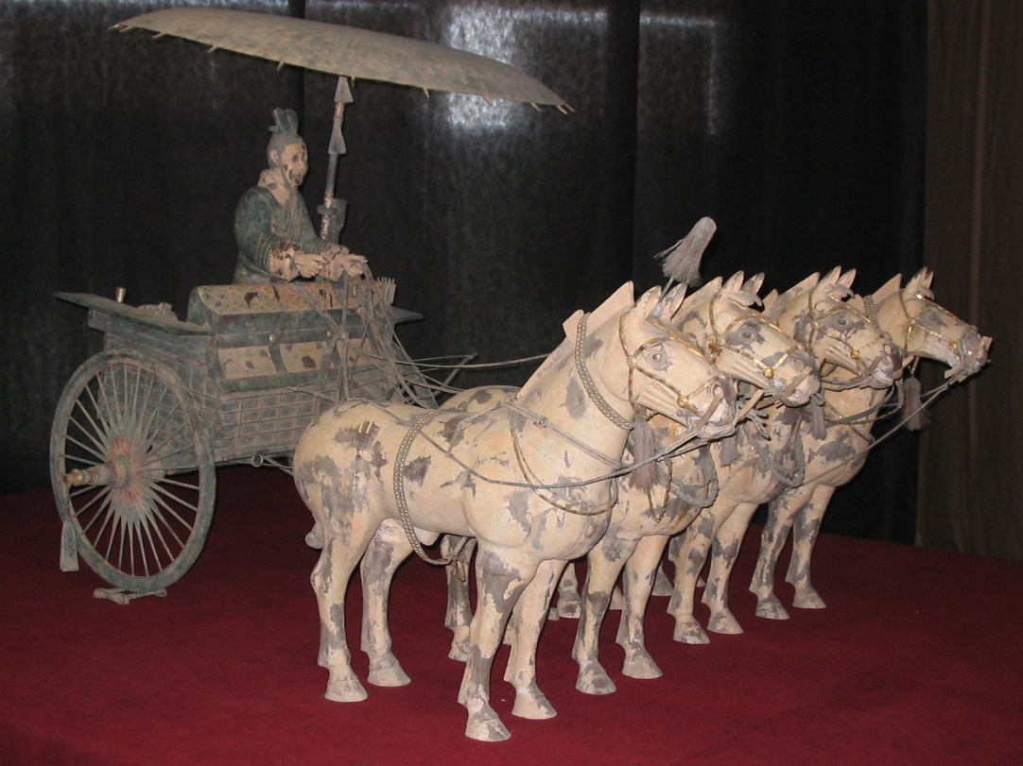

Slide 21
Why did the Qin Dynasty Fall?
Shi Huangdi
Extremely paranoid; killed off suspected enemies (nobles, intellectuals, warlords)
Desire to control EVERYTHING
High taxes, forced labor
Shi Huangdi dies in 210 BCE; followed by 8 years of peasant revolts to determine successor - winner establishes Han Dynasty

Slide 22
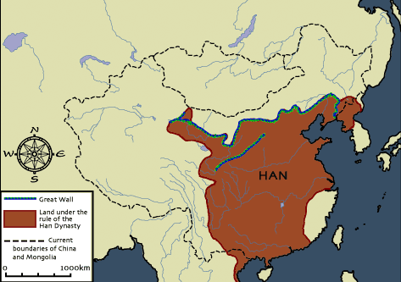

Slide 23
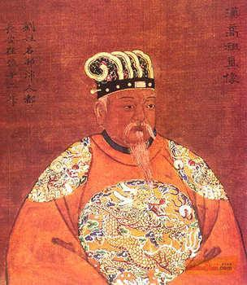
Establishment of Han Dynasty 202 BCE - 220 CE
Liu Bang - leads peasant revolts after death of Shi Huangdi
202 BCE - Liu Bang has eliminated almost all of his competition through military might and diplomacy

Slide 24
Han Society
Some lower classes allowed into bureaucracy
Strict emphasis on family relationships
Women
Patriarchal
Some could gain influence through male relatives
Three main groups:
Landowners & educated bureaucrats
Peasants and Artisans
“Mean People” - merchants, actors, musicians

Slide 25
Han Politics/Government
Centralized administration, with less brutality than Qin dynasty
Improved bureaucracy
Attacked warlords/regional princes
Focused less on military buildup
Emphasized Confucianism - education for bureaucrats
Wu Ti - most famous emperor (140-87 BCE)
Brought peace to much of Asia
Expanded territory
Civil Service Examination

Slide 26
Han Interactions
Expansion into Korea, Vietnam and Central Asia
Expanded contact/trade with India and Persian empires
Later with Roman Empire

Slide 27
Han Culture
Treated Confucianism as religion-shrines constructed
Gov’t promoted philosophy
Continued construction of Great Wall
Innovations - Seismograph, anatomical research, hygiene
Animal collars
Pulleys and gears
Increased production of textiles
Water-power mills
Paper

Slide 28
Han Economy
Taxes lower than Qin, but get higher as dynasty progresses
Copper coins
Required people to work on gov’t projects
Gov’t influenced and controlled parts of economy
Iron and Salt production
Weights and Measures
Trade - silk, jewelry, leather goods, agricultural goods
Public works programs - canal systems
Store surplus of rice and grain

